Slide 1
Early Reading Hub
Jo Puttick, Emma Spiers, Monika Singala and Marissa Gisbourne
2025-26
Notes:
8.45am

Slide 2
Aims of the programme
To support early reading leaders to deepen their understanding about meeting the needs of readers who have a range of needs that affect their reading progress.
To develop early reading leaders’ confidence in identifying what works well in the development of early readers in their school and what needs to be adapted to improve impact.
To understand how to continue to motivate learners who find the reading journey difficult.
To recognise that early reading relates to children across the age groups who are still in the early stages of reading.

Slide 3
14.10.25. | Building strong foundations in reading: What has been the impact of your phonics scheme on early reading development? How does the phonics relate to expectations in early reading? Texts to support SEND learners Motivating children who find reading difficult to want to read
Gap task Monitor your phonics scheme: learning walk, video coaching, listening to pupils read OR Resource audit of texts for low reading age, high interest for children in Y2 – Y6 and for your SEND pupils
20.1.26. | Key findings from phonics programme monitoring How does dyslexia impact on learning to read and how can you support these learners? Phonological awareness intervention What is autism, how might it affect early reading and what strategies support progress?
Gap task Use the Early Years dyslexia checklist to consider the reading development of 2 pupils who are finding the reading journey difficult. Intervene to support these learners. Implement some strategies from the autism session on pupils who are finding learning the hardest
7.5.26. | How does language impact learning? Supporting EAL learners to read Interventions to support vulnerable children to learn to read
Gap task Monitor and evaluate the progress of SEND and vulnerable learners: support wider staff to develop the subject knowledge required to better support these learners.

Slide 4
Aims of session 3
Understand the importance of language comprehension in reading.
Understand how to support EAL learners in reading.
Notes:
Jo - 8,50

Slide 5
Gap task
Take either possible dyslexic child / or autistic child. Work with them as a reader OR do a phonological awareness check. Using provided activities, decide what might be worth trying from the session.
OR
Use the Early Years dyslexia checklist to consider the reading development of two pupils who are finding the reading journey difficult. Intervene to support these learners.
OR
Implement some strategies from the autism session on pupils who are finding learning the hardest.
Notes:
Jo

Slide 6
Understanding how EAL learners learn to read
Notes:
Jo

Slide 7
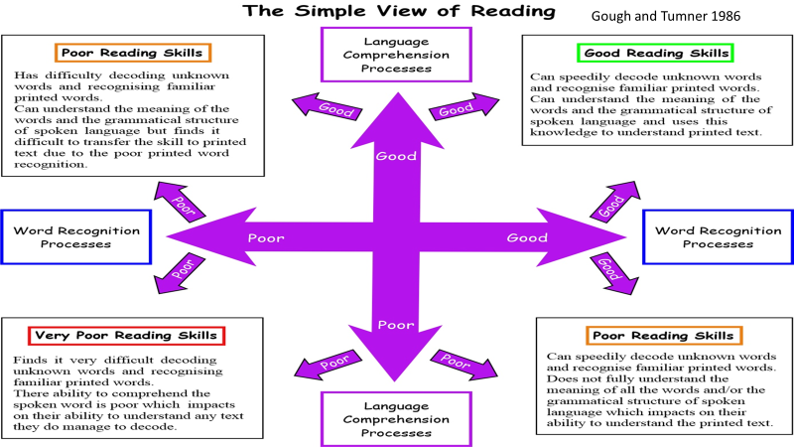
Simple View of Reading

Slide 8
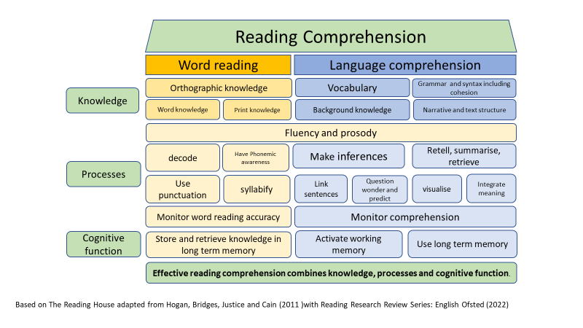
Notes:
EAL learners / language deprived - make the point - the same strategies though not the same children in the same groups: rapid catch up for EAL learners - Benefit to having 1 language already

Slide 9

Parallel
tracks
Phonics and common exception words
Language comprehension and expression
Notes:
JO
Parallel tracks: phonics and word reading on one, language comprehension on another - the 2 converge - clear and explicit teaching of each element

Slide 10
Phonics matters
Carry out an assessment: can the pupil blend (and segment)? Does the pupil already know some graphemes?
Do you need to fill gaps? What are they? Construct a bespoke programme based on your scheme.
Do you need to identify a starting point in the scheme and work through the scheme from that point onwards?
Small group or one to one? Who will be teaching them?
Can the learner cope with a faster pace than you would expect for young learners?
Reading and writing
Notes:
Phonics teaching - don’t put EAL learners in LA groups for phonics

Slide 11
Phonics teaching flow-diagram
Assess pupil
Teach phonological awareness and begin the programme from the beginning. Consider: can you teach the programme more quickly?
Identify the starting point in the scheme: work from there
Identify gaps: construct a bespoke programme to teach to the gaps.
Regularly re-assess pupil

Slide 12
Common exception words matter
Basic list of common exception words: more than your phonics scheme?
Based on RR or PM book bands?
Reading and writing

Slide 13
Knowing about text
Directionality of print
Front and back cover
Reading from front to back
Top of the page to the bottom of the page
Left to right
Punctuation marks show how to read

Slide 14
Linking class and intervention
How do you support learners who regularly go out to interventions?
How could you support them?

Slide 15
Generic language development ideas
Read picture books aloud: book talk for older learners, based on texts linking closely to classroom learning and basic familiar settings.
Shared and paired reading of books.
Repetition of these books including using audio books: repeated reads develop language.
Use Usbourne 1000 words to build basic noun knowledge, then add in verbs that link.
Colourful semantics to teach and practise basic sentence structure.

Slide 16
Generic language development ideas
Support learners by providing some background knowledge to support understanding through visual support and succinct explanation.
For older children working in classes with longer text: film version? Create a short story version as pre-teach?
Find a version in home language?
Notes:
ES

Slide 17
Valuing home language
How many languages do they speak?
What are they?
Having other languages matter. In what ways do they support learners to learn to read in English?
Notes:
ES

Slide 18
Valuing home language
Dual language texts for home-school reading if appropriate.
Use of video and audio.
Encouraging some talk about books in home language where you have other speakers of that language in your class or at home.
Notes:
ES

Slide 19
For pupils at the early stage of learning English as an additional language
Ofsted Toolkit 2026
Leaders and teachers recognise that these pupils already speak at least one language and do not lower their expectations of them
Teachers assess pupils’ English language proficiency accurately and regularly
Teachers recognise that providing opportunities to talk with peers during lessons is important; teachers help pupils articulate what they know and understand by scaffolding, modelling, extending and developing their ideas

Slide 20
For pupils at the early stage of learning English as an additional language
Ofsted Toolkit 2026
Teachers focus on the vocabulary pupils read, including subject-specific vocabulary, to help them understand new concepts; they keep explanations clear and precise
Teachers develop and extend pupils’ language carefully and deliberately with plenty of repetition
Teachers ensure that pupils learn to read using systematic synthetic phonics as soon as possible so that they have access to a wide range of literature that will accelerate their understanding of English

Slide 21
Reflection
What currently happens for EAL learners in phonics and word reading?
What currently happens for EAL learners in language development?
How rapid is their progress?
Who might you worry about?

Slide 22
EAL learners or all learners?
Consider the cognitive load of the language within the learning.
Limit the teacher talk.
Use visuals to support language understanding.
Build in repetition…build in repetition…build in repetition!
Notes:
Jo - What is good for EAL is good for all of them!!
What is good for SEN…
Visuals for vocab
Avoid cognitive load

Slide 23
How to develop vocabulary
We can’t rely on reading alone to support pupils to develop vocabulary.
The EEF recommends:
*Carefully selecting HFW/key vocabulary and teach explicitly.
*Developing the number (breadth) of words children know along with their understanding of relationships between words and the context in which words can be used (depth).
*Provide multiple opportunities to hear and use vocabulary.
Notes:
Monika - 9.40 - 10.00
Self regulation strategies

Slide 24
Definitions
Common pitfalls when explaining vocabulary to pupils are:
*Using the word itself in the definition.
*Tier 2 language used in the definition which isn’t helpful as that creates more words that pupils don’t understand.
*Definitions that are too long and not succinct.
Notes:
Monika - 9.40 - 10.00

Slide 25
Definitions
Mumble
Proud
Frustrated
Glimpse
Curious
Ignore
Request
Approach
Grumpy
Reluctant
Notes:
Monika - 9.40 - 10.00

Slide 26
Language Acquisition
1: Learn in context
2: Learn in figurative context
3: Practice and use
4: Apply in different ways
5: Apply in writing
Spaced retrieval
Notes:
Monika - 9.40 - 10.00
4 week forgetting curve - The forgetting curve represents the rapid decline of memory retention over time, often reaching roughly 50% to 90% loss of new, unreviewed information within just a few days to a week. By the end of 30 days (roughly 4 weeks), retention can drop to as low as 5% without active recall or spaced repetition.

Slide 27







CLS recommends – Dual Language and Word reading
29 or more different language translations
Over 100 different languages
Ukranian
Notes:
10.00 - 10.15 - Marissa

Slide 28



CLS recommends – Dual Language and Word reading
Notes:
10.00 - 10.15 - Marissa

Slide 29







Diverse cultures in picture books
Notes:
10.00 - 10.15 - Marissa

Slide 30

BREAK
Notes:
10.15 - 10.30

Slide 31
The Communication Chain in action
Receptive and expressive language are essential parts of sharing and expressing opinions about reading.
Receptive language is always evident first and builds confidence.
Receptive language provides a model for expressive language.
The communication chain can be used as a diagnostic tool.

Slide 32
The communication chain
and how this relates to reading
Make your own chain!
Notes:
Emma -10.30 - 10.40

Slide 33
Receptive Language
I hear what is said
I pay attention to what is said
I interpret non verbal communication
I remember what is said (auditory memory)
I understand what the words mean
I understand the sentence structure
I interpret meaning (literal / not literal)

Slide 34
Top tips for supporting EAL readers
Say less
Use simpler versions of texts
Use gesture and intonation more
Use visual reals rather than symbolised structures
Repeat more
Know which words are understood
Use simple sentences
Plan before you start

Slide 35
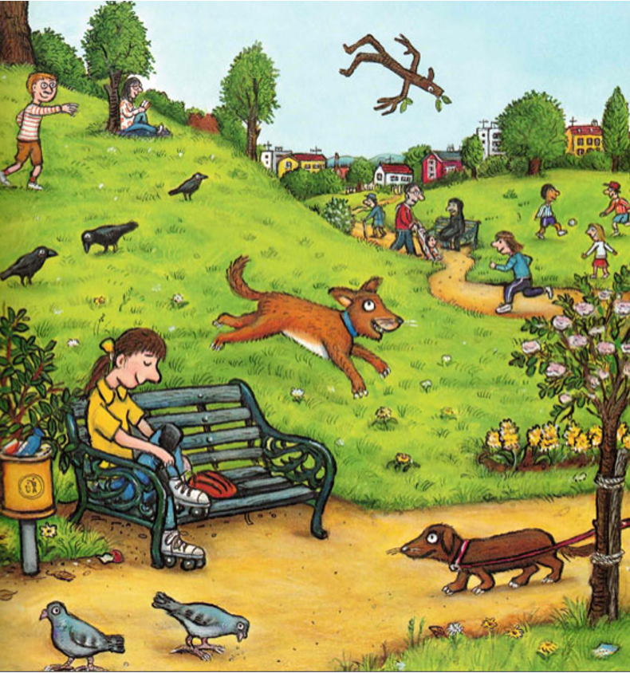
Say less
Use simpler versions of texts
Use gesture and intonation more
Use visual reals rather than symbolised structures
Repeat more
Know which words are understood
Use simple sentences

Slide 36
Expressive Language
I think about what to say
I choose the words I need
I use the words I know to create a sentence or phrase
I select the sounds to say the words
I say the words in order
I use non verbal communication
I consider the impact on the listener

Slide 37
Top tips for supporting EAL readers
Allow plenty of processing time.
Provide plenty of non verbal encouragement.
Repeat words back with the correct pronunciation.
Recast some sentences for greater grammatical accuracy.
Expand on simple sentences to include information carrying words.
Don’t overwhelm with feedback.

Slide 38
Recasting and
expanding language
Him go up
Football
Him running (girl)
Birds (pigeons)

Slide 39


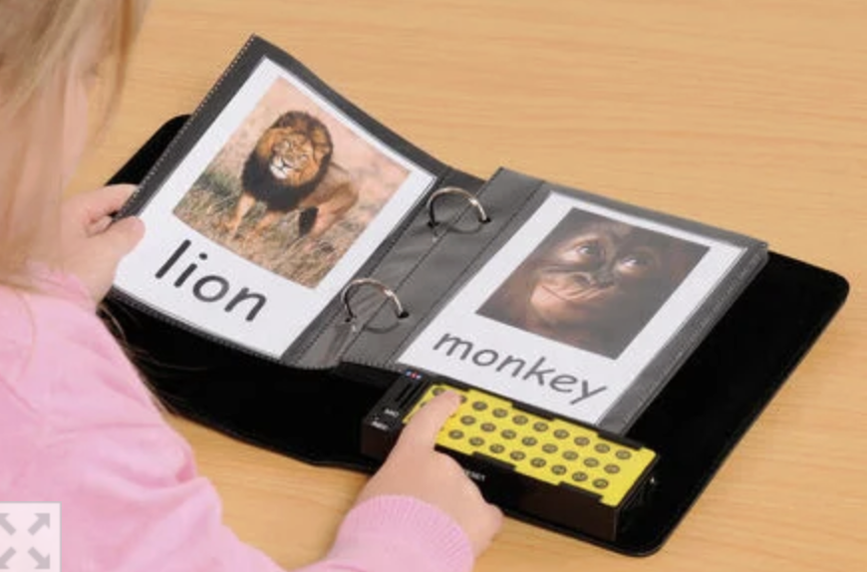
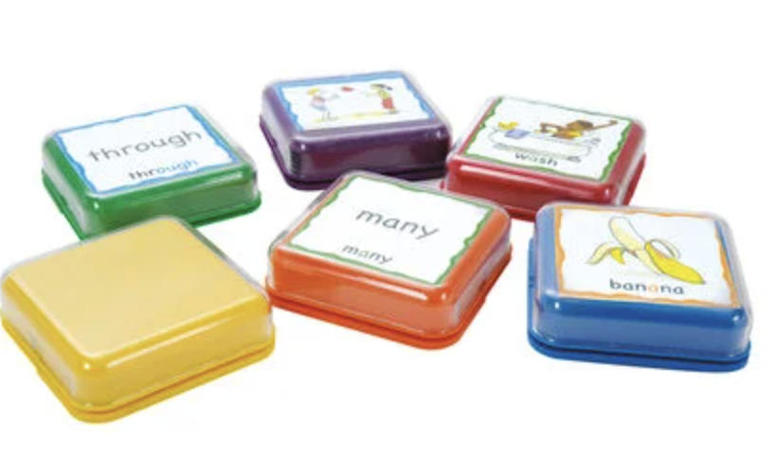
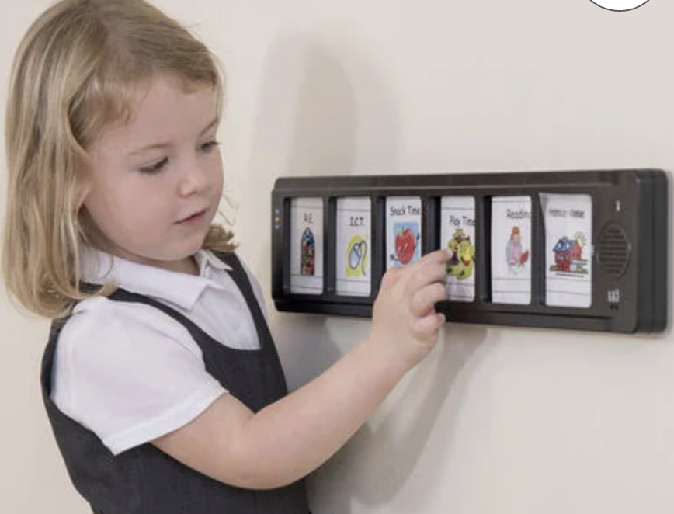
Developing Language
Begin with the familiar, becoming more abstract as language is acquired

Slide 40
What can you see in the picture?
How does the character feel?
What do you think will happen next?
Notes:
Emma -10.30 - 10.40

Slide 41
Interpreting Comprehension Questions
Does the reader understand the question?
Revisit the Blanks Level Questions.
Don’t rely on the comprehension questions in the book.
We can’t draw out what’s not there.

Slide 42
Providing sentence stems
Putting words together in the correct order can be overwhelming.
Having sentence stems that children learn to repeat can reduce cognitive load.
Progression in Language Structures Tower Hamlets

Slide 43
The Language of description
It looks like…
It is the same because…
It is different because…
Language of opinion
I like this because…
I don’t like this because…
I think that…
She / he / we/ they think that…
Language of sequencing
First…
Next…
Then…
In the end…

Slide 44
Motivation to learn language
Notes:
11.15 - 11.30 - Jo- the right text

Slide 45
What motivates me to learn English when I move to the UK?
Do now:

Slide 46
What might de-motivate me to learn English when I move to the UK?
Do now:

Slide 47
Consider the learning in the classroom
Teach your class how to support and play with someone who speaks a different language.
Teach your class about the country and culture the child has arrived from.
Use a buddy system so the learner has developing friendships and develops social language.
Teach the tier one words required for access to the lesson.
Pre-teach basic content or background knowledge required for lessons (using another learner in the class?).
Use pictures and diagrams to support the learning.
Keep explanations clear and succinct.

Slide 48
Consider the choice of reading material
Age appropriate text
Phonics appropriate?
Build sight vocabulary quickly
Whole language progressive texts as well as phonics based text? (colour banded / PM-type books)?
Books with diverse character representations (NOT stereotypes)
Good quality picture books to support language understanding

Slide 49
Take care of pace for EAL learners
Are they only learning language in the classroom?
Should they be placed in groups with learners who process new learning slowly?
Buddies support language learning
Books and visual media support language learning
Set high expectations for language acquisition and pace of learning phonics
Notes:
Jo 11.25 - 11.30

Slide 50
Key messages
Notes:
Jo 11.30 - 11.40
Reminders to finish
/ immersion in language / modelling / dual coding in vocabulary / opportunities to talk / structuring talk / new words build on words you already have

Slide 51
Key messages
Teach phonics and word reading separately from language comprehension.
Immerse EAL learners in good quality language.
Model good quality language.
Use picture books to support developing understanding.
Dual code for vocabulary: picture and symbols help.
Build new vocabulary on words you already have.
Support learners to structure their talk.
Provide opportunities to talk and construct language.
Ensure that books represent a range of people from a range of backgrounds and cultures.
Do NOT accidentally place a limit on development: High expectations matter.
Notes:
Jo
Reminders to finish
/ immersion in language / modelling / dual coding in vocabulary / opportunities to talk / structuring talk / new words build on words you already have

Slide 52
Further reading
https://share.google/1rDj0hIL79yvlsL0m
Teaching EAL Learners in English Literacy, English and English Literature - Bell Foundation

Slide 53
Gap task
Audit resources for EAL learners
Go and observe a lesson: how does this lesson work for your EAL learners: imagine you have very little English…
Identify from the key messages one aspect to work on with the whole staff
Notes:
11.35am Jo

Slide 54

Evaluation
Thank you for providing feedback before you leave!
(Today / content for next year / end of programme evaluation)
Notes:
11.37 - Talk about ideas for next year / put on post its as well as in Evaluation - because there are leaders that are new - repeating content - can send someone else
Parents / reading for pleasure???? / guided reading?? How to adapt LW? / book corners - reading in the environment? - for national year of reading

Slide 55
Research overview
Research Review Series Ofsted (2022)
Early Years Statutory Framework DfE (2020)
Preparing for Literacy EEF (2018)
Improving Literacy in KS1 Guidance Report EEF (2020)
The Reading Framework: Teaching the Foundations of Literacy DfE (2021)
Understanding reading comprehension Oakhill et al (2015)
Speak for Change APPG (2021)
The Science of Reading Comprehension Instruction Duke et al (ILA The Reading Teacher 2021)

Slide 56
Do now

