Slide 1
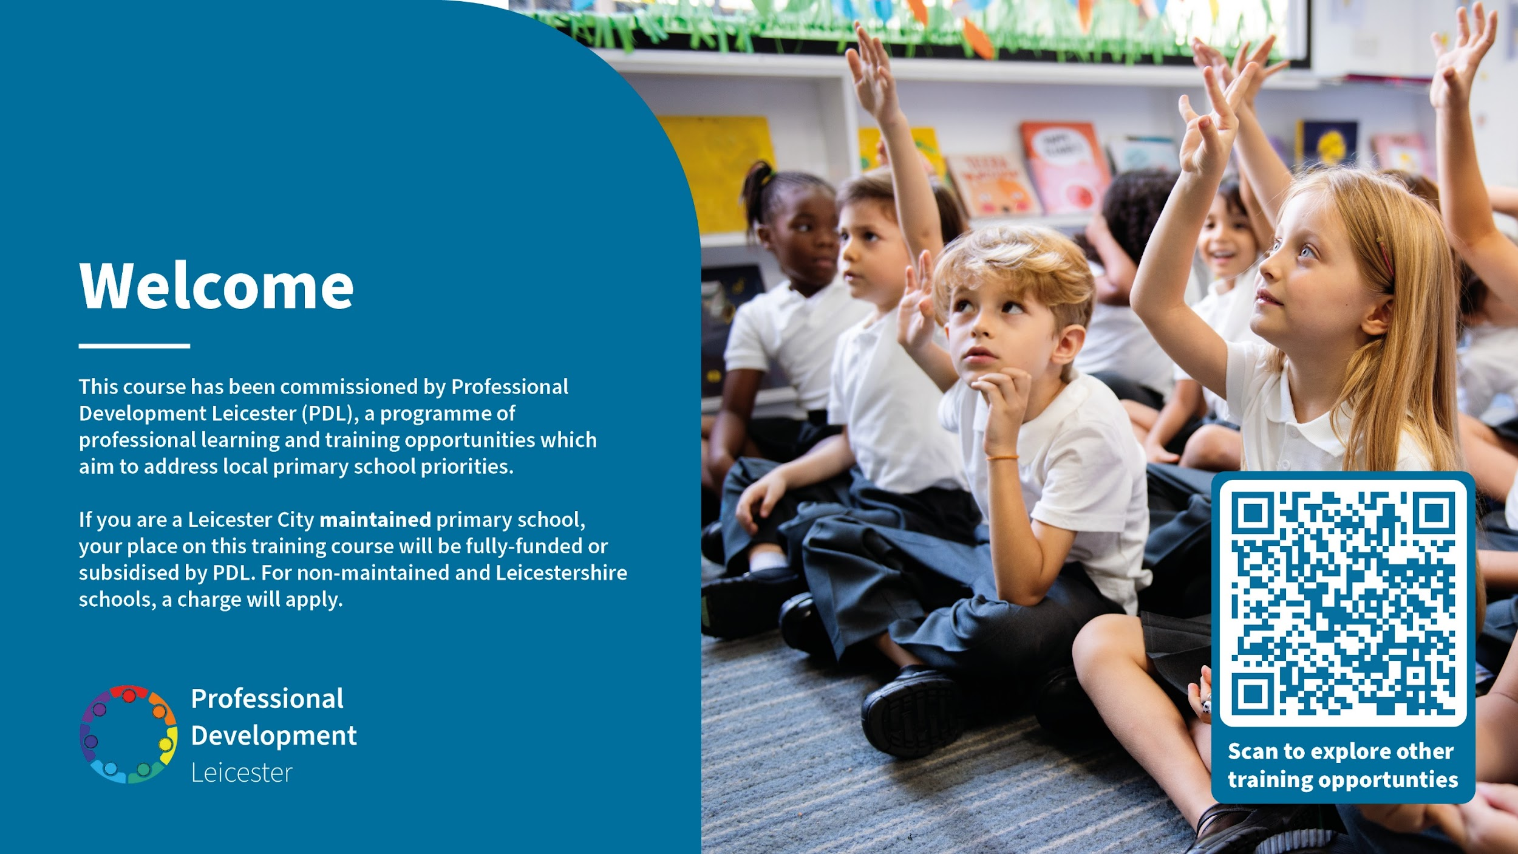

Slide 2

Voice Leicester
Oracy Leaders’ Network 3 – Spring 2 2026
Course lead: Hannah Cooper
Expert Practitioner: Laura Bisiker

Slide 3

Aims of the networks
Build on subject knowledge
Discuss with colleagues and expert practitioners
Be immersed in transferable oracy strategies that can be used back in the classroom
School-to-school support
Keep up-to-date with good practice & current initiatives

Slide 4
Network 3 Agenda
Introduction
Gap Task Review – Sharing Practice – using oral rehearsal to teach writing / Trialling the Third Move
An Oracy Sequence of Learning to support a Written Outcome
Next Steps

Slide 5


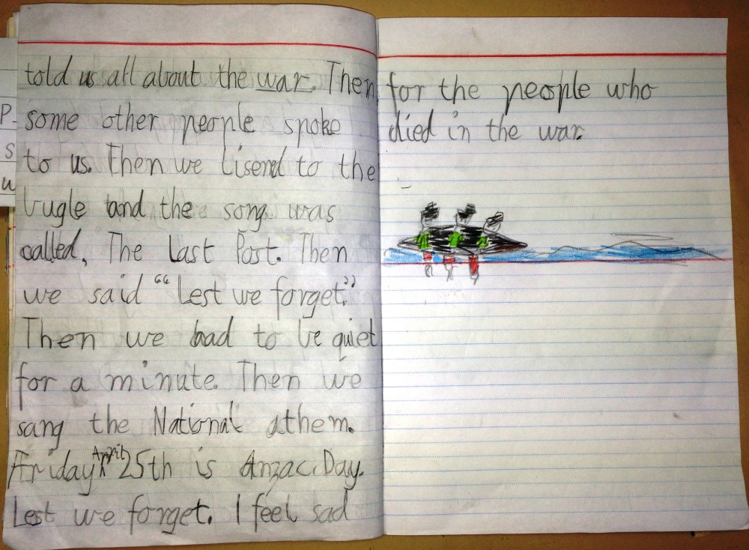
Odd one out
This Photo by Unknown Author is licensed under CC BY-SA-NC

Slide 6
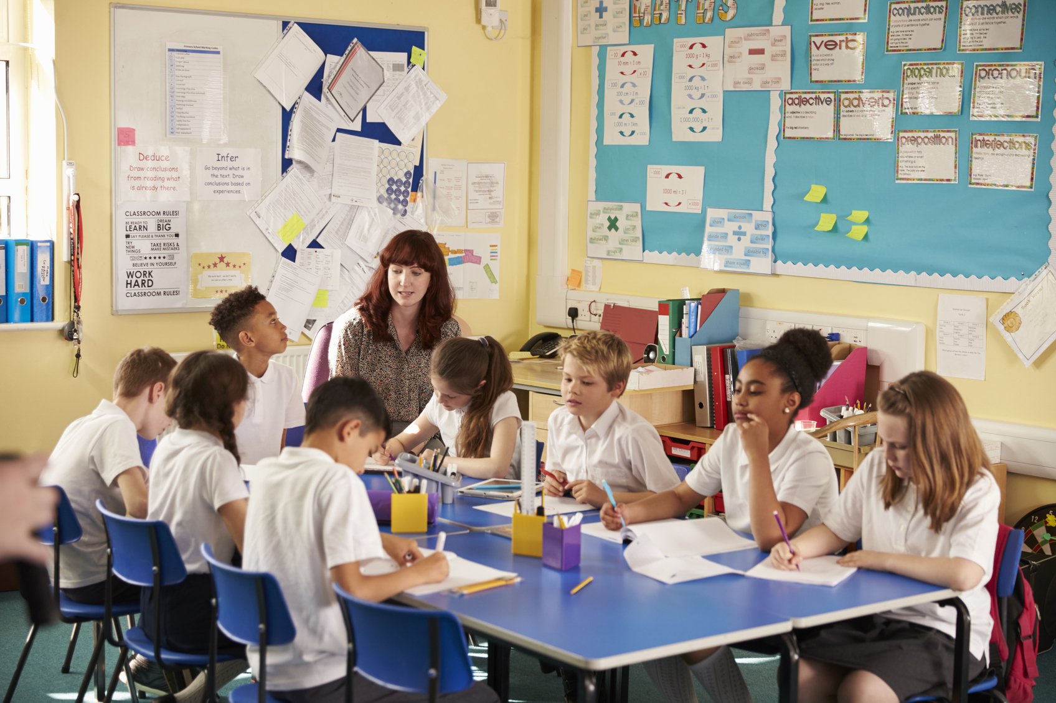
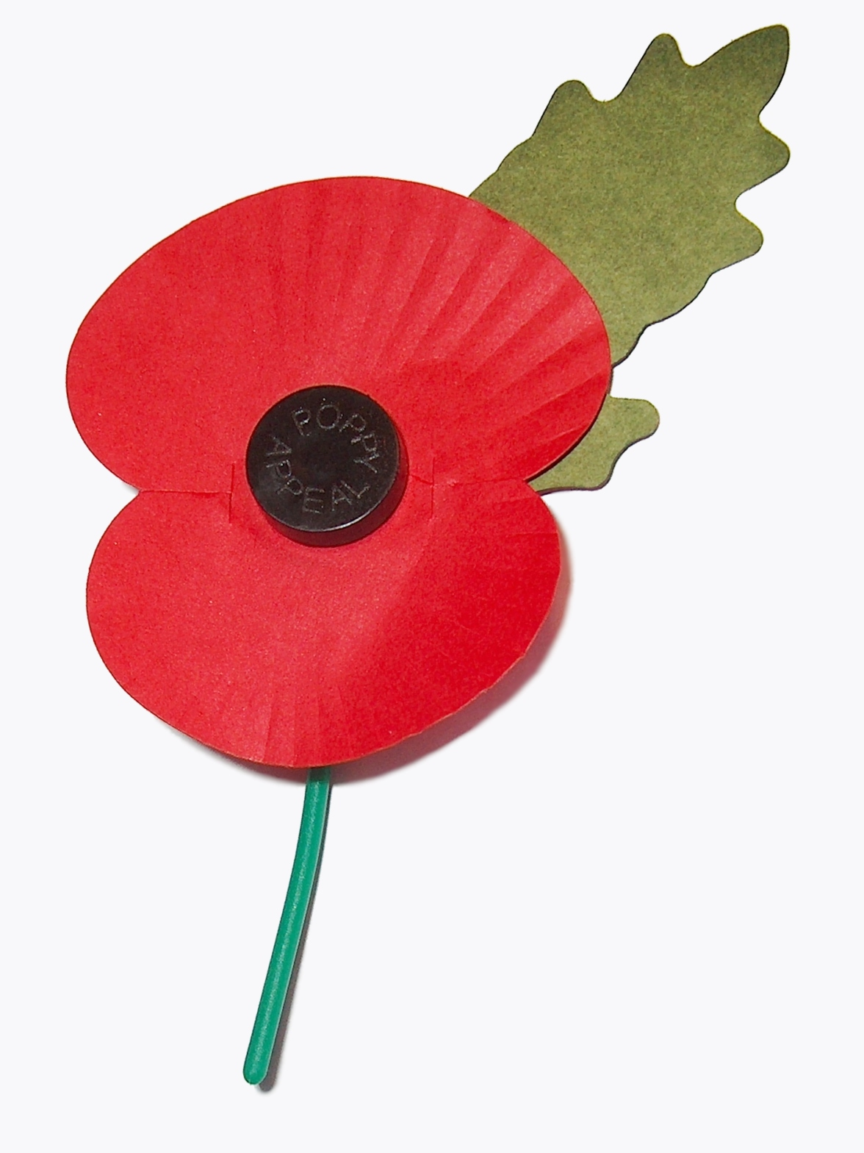
How do they link?
ThePhoto by PhotoAuthor is licensed under CCYYSA.
This Photo by Unknown Author is licensed under CC BY-SA-NC

Slide 7
Gap Task - Using Oral Rehearsal to teach writing
Purpose of talk
Structure
Scaffolds
Reflection
What is the writing learning objective? How will you use oral rehearsal to support this learning?
What teaching strategies / activities will you use?
What scaffolds will you use?
Consider the writing outcome - how has the oral rehearsal elevated the learning and application of the writing skill?
Trial using the ‘Third Move’
- Record
- Transcribe

Slide 8

Sharing Practice
Speaker
Listeners
Present your practice
Respond to feedback & questions
Select a timekeeper
Listen to the presenter first
Note any questions / comments
Discuss after the presentation
Discuss which person’s practice will be presented and shared with the wider group
A ‘listener’ will feedback to the wider group
This Photo by Unknown Author is licensed under CC BY-SA

Slide 9
Your Oracy Toolkit
Oral Rehearsal
Reasons for Oral Rehearsal
Structured Talk Routines
Different strategies & routines
Rehearsal for writing
Vocabulary & language development
Drama & embodied talk
Retrieval, sequencing & memory-supportive talk
Practical discussion & idea generation
Assessment, feedback & reflection
Sharing Practice
Anything to add?

Slide 10

Oracy Master Class
Laura Bisiker – Imperial Avenue Infant School
Oral Rehearsal within a writing teaching sequence

Slide 11
Take note of examples of oral rehearsal that are used
Sentence stems
Key vocabulary
Talking points
Thinking time
Questioning
Fed in facts
Pair talk
Trio talk
Group talk
Praise
modelling
Consensus circle

Slide 12


Slide 13
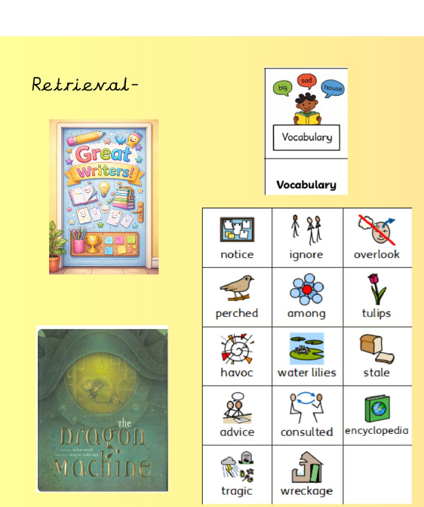
My Dragon Machine

Slide 14
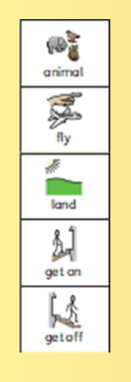
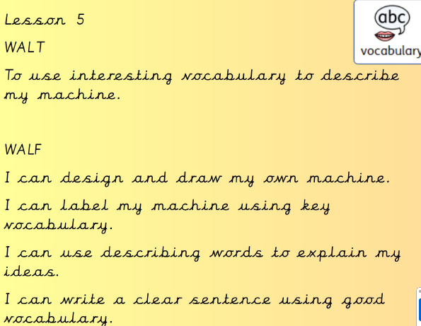
My Dragon Machine

Slide 15
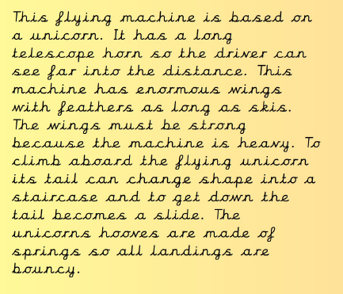
Teacher Example

Slide 16

Teacher Example

Slide 17
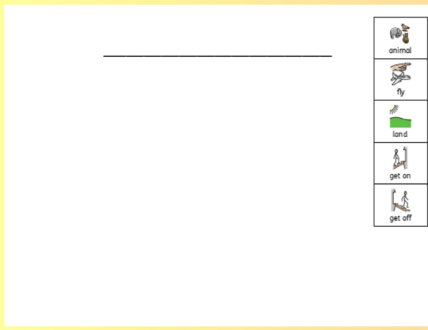
Idea generating

Slide 18
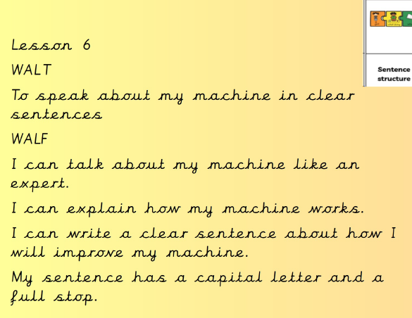

Slide 19
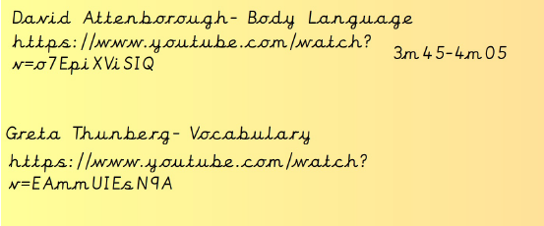
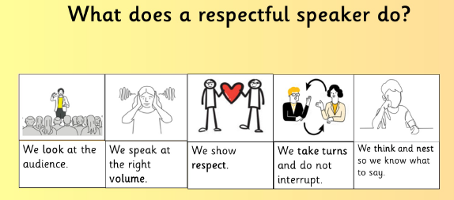
Example Talk

Slide 20
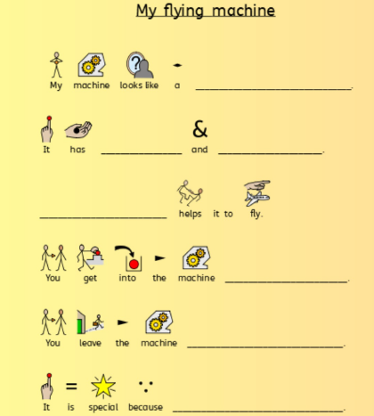

Talk Frame

Slide 21
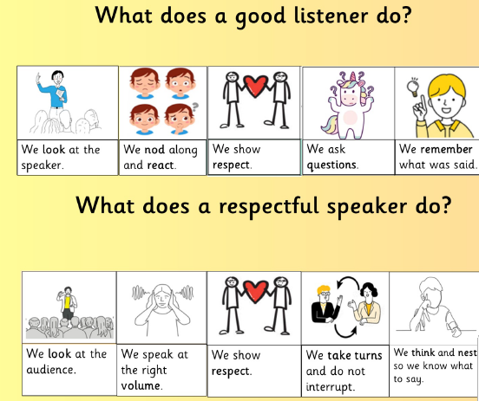
Presentation

Slide 22
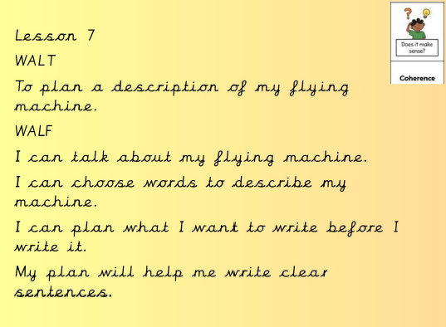

Slide 23
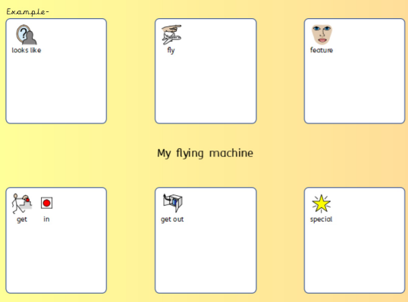
Model Plan

Slide 24
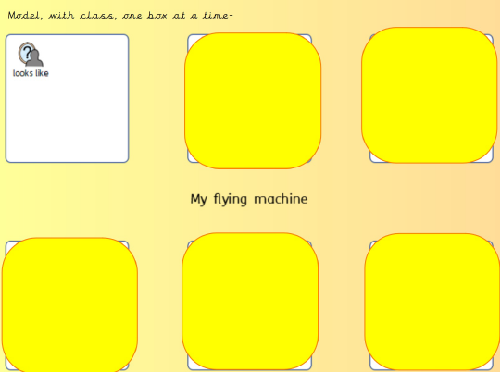
Planning

Slide 25
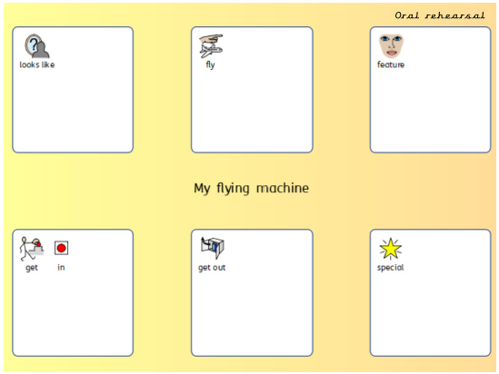
Oral rehearsal

Slide 26
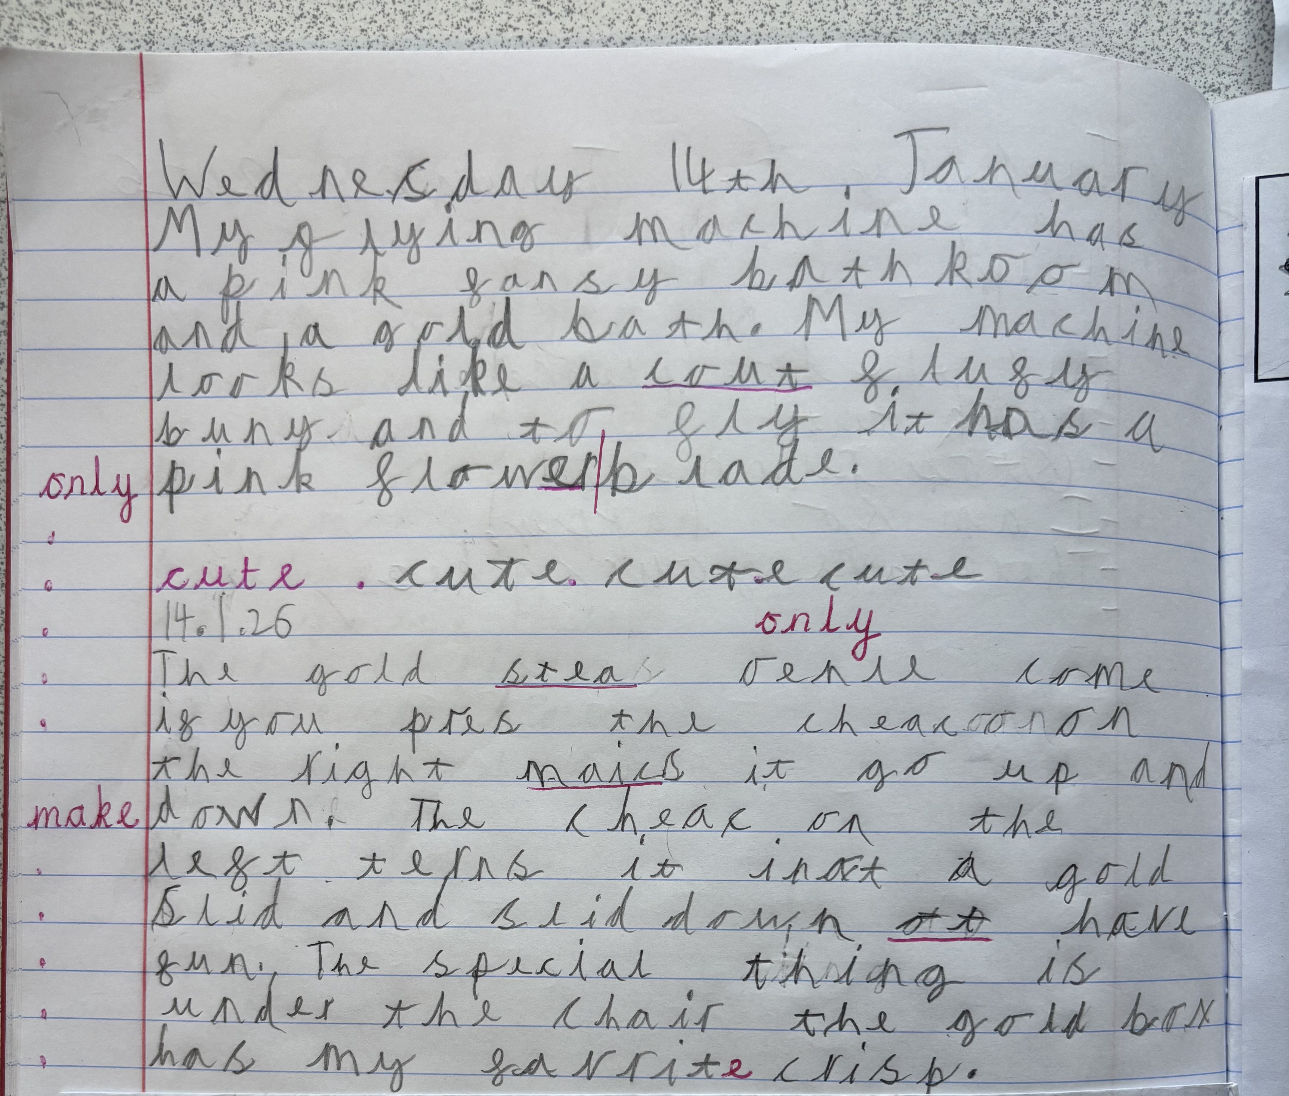
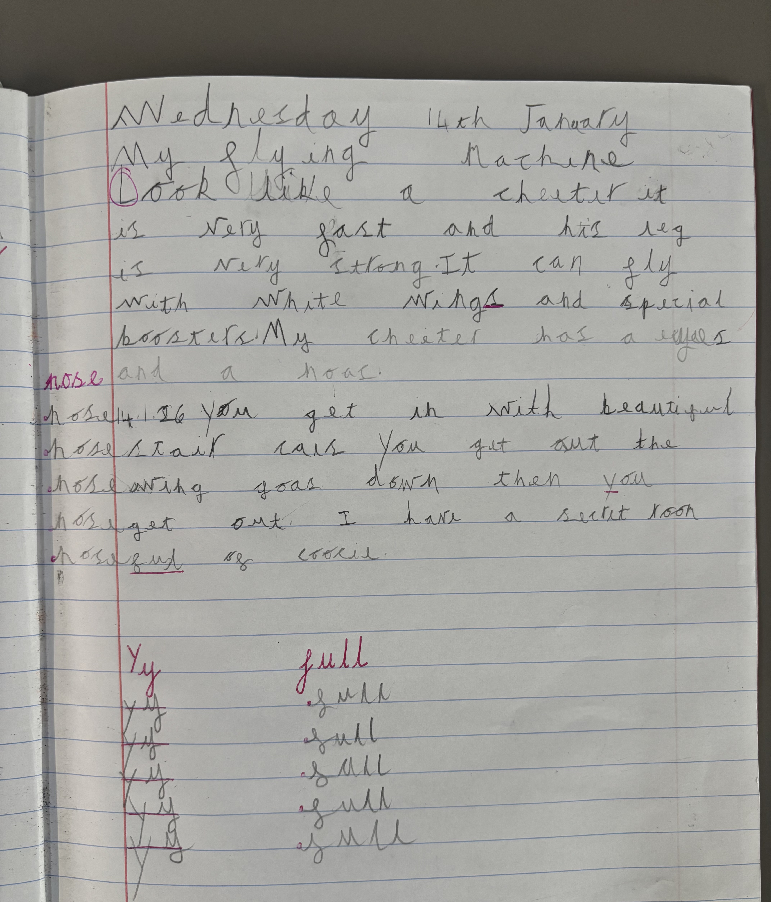
Example writing

Slide 27
Which examples of oral rehearsal were used?

Slide 28
Over to you…

Slide 29
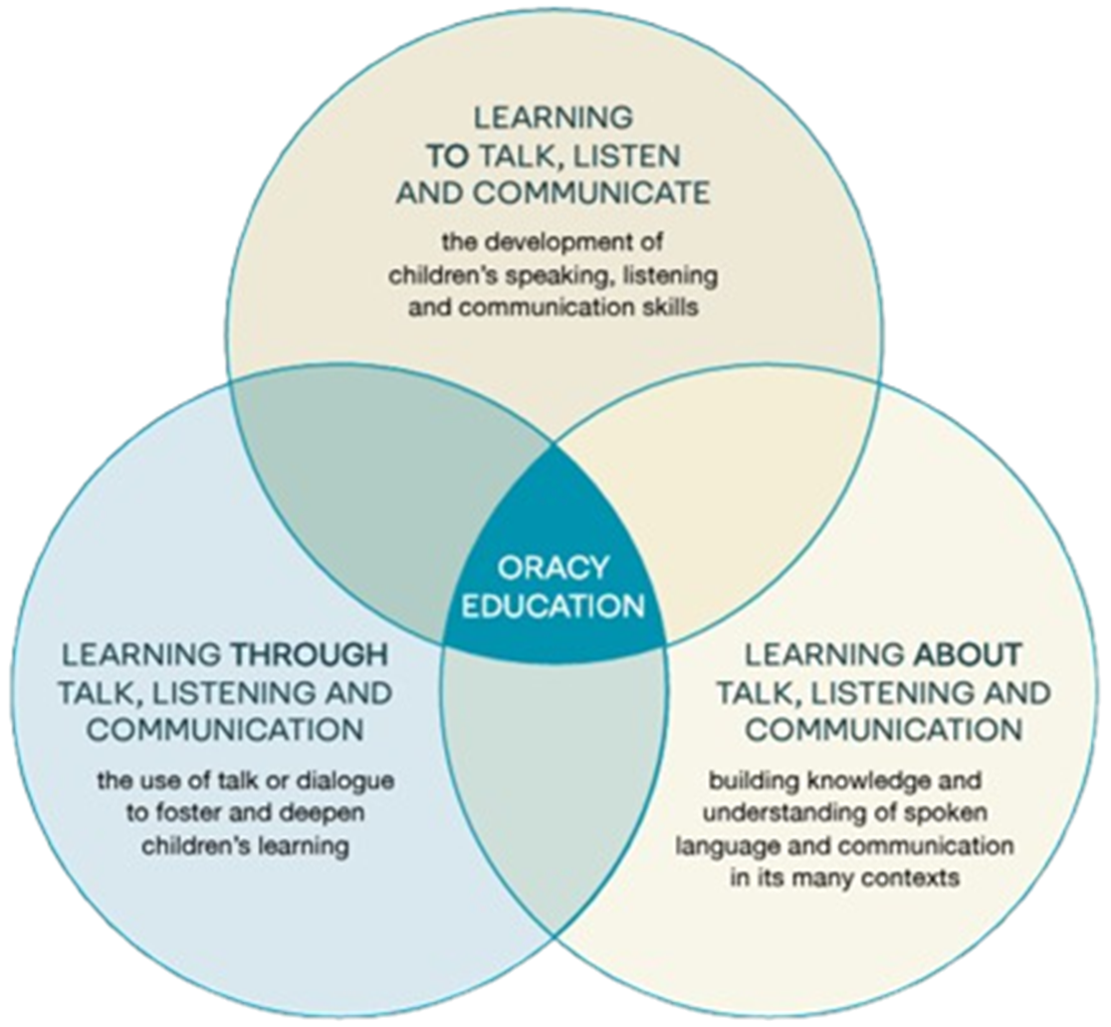

Next Steps for Oracy in Your school / classroom
The National Curriculum for Speaking & Listening
Dialogic Classroom
Three-way Venn for Oracy Education
Learning to …
Learning through …
Learning about …
Third Move
Supporting the writing lesson sequence
The Writing Framework
Oral Rehearsal
Other

Slide 30
Further Oracy Support coming up …
Oracy networks next year
Bespoke support

Slide 31
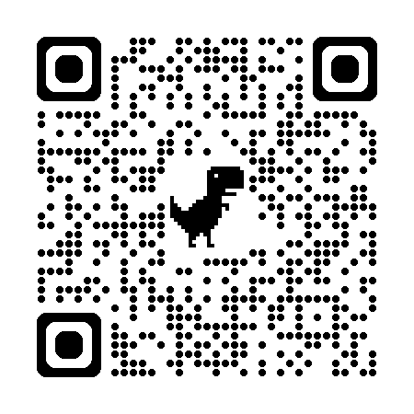
Evaluation
We’d be very grateful if you could please share your feedback before you leave.
Thank you!

