Slide 1
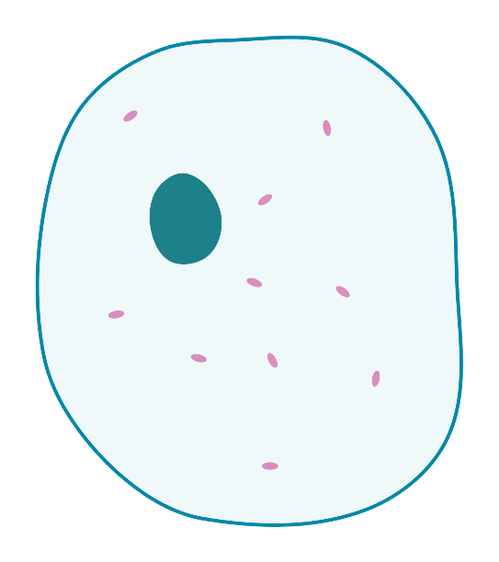

Slide 2
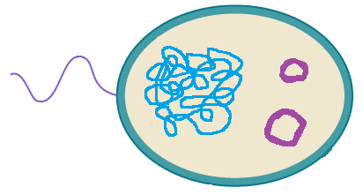

Slide 3
1 An animal cell has a nucleus which controls the cell and contains the DNA that determines the cell type and function. It is a small round shape within the cell. | 2 Bacteria cells have plasmids, small, circular molecules that are distinct from the cell’s chromosomal DNA. | 3 Cytoplasm is where chemical reactions take place in both animal and bacterial cells. It fills the cell and gives its shape.
4 Bacteria do not have an enclosed nucleus. Instead, they have a single, continuous strand of chromosomal DNA. | 5 A bacteria cell sometimes has a flagellum, which is a microscopic whip-like appendage which enables the bacteria to swim. | 6 Both types of cells have membranes. These are permeable, allowing substances in and out of the cell. Some bacteria cells may also have a cell wall.
7 Animal cells have mitochondria which produce energy through respiration. Numerous mitochondria can be found in a cell, depending on its type. | 8 A bacteria cell is much smaller than our cells.

Slide 4
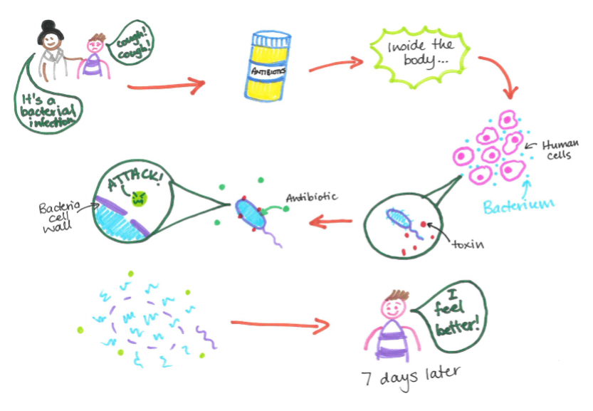
How do antibiotics work?

Slide 5
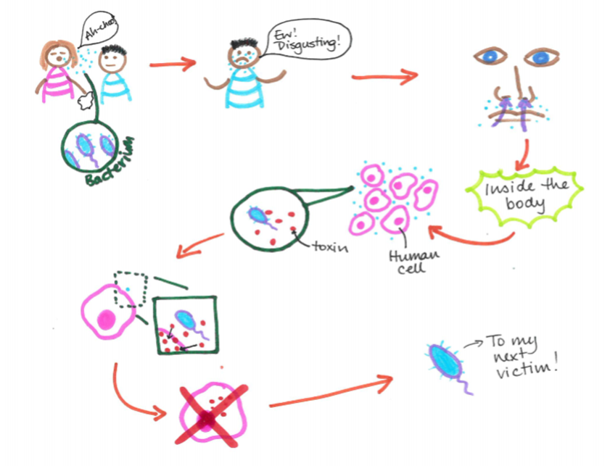
How does infection occur?

Slide 6
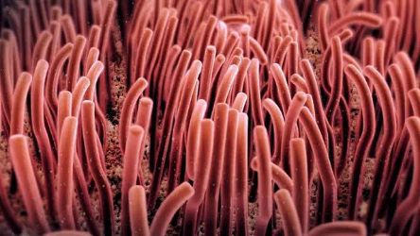
How does infection occur?
Bacterial infection | Cilia | Damage
Toxins | Cell | Nasal hair
Release | Bacterium | Inhale

Slide 7
How do antibiotics work?
antibiotics | releasing toxins | bacterium
break down | cell wall | explode
attack | cells | prescribes

Slide 8
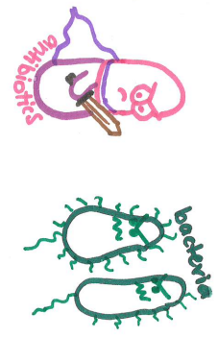
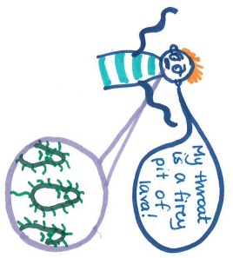
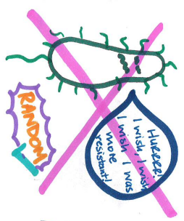
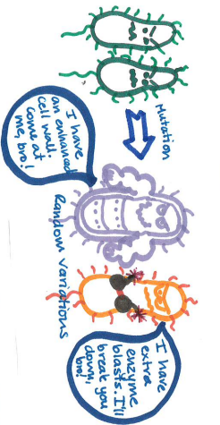
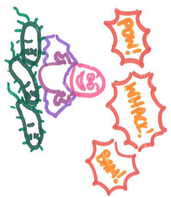

Slide 9
