Slide 1
“[Talk is] the most powerful tool of communication in the classroom and it’s fundamentally central to the acts of teaching and learning”
-Professor Frank Hardman
Supporting Discussion
Course lead: Hannah Cooper

Slide 2
Creating a culture of talk in the classroom
Review from session 1
What is a Dialogic Classroom?
Strategies to support developing a Dialogic Classroom:
Discussion Rules
Speaking & Listening
Aims of the day

Slide 3
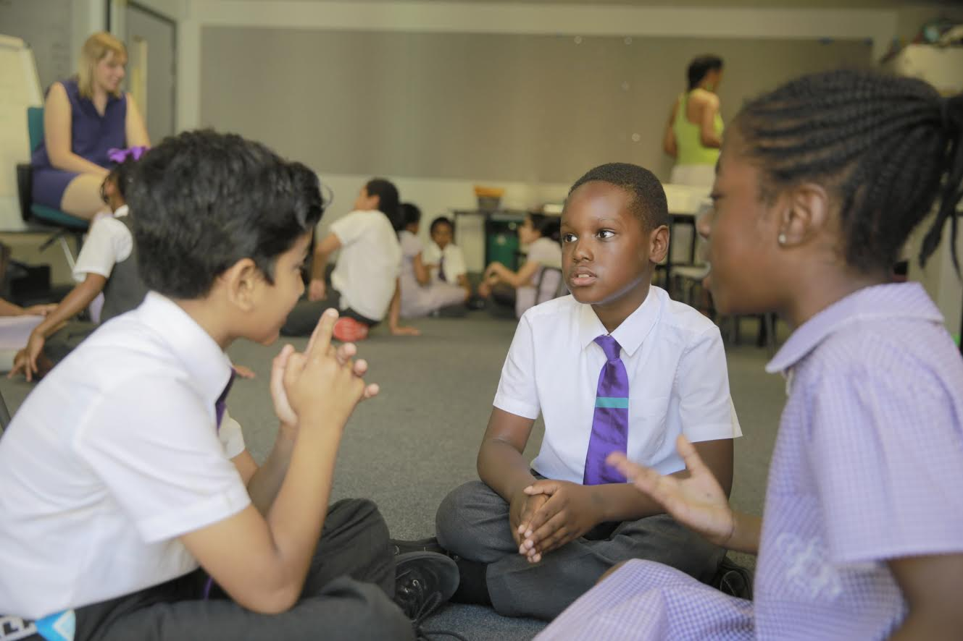
Your Classroom Practice - Review
How does talk support learning?
What are the expectations for talk?
Are there opportunities to develop the four strands?
Are children learning to talk?
Are children learning through talk?
What was your role in the lesson?
Consider the Teacher Benchmarks

Slide 4
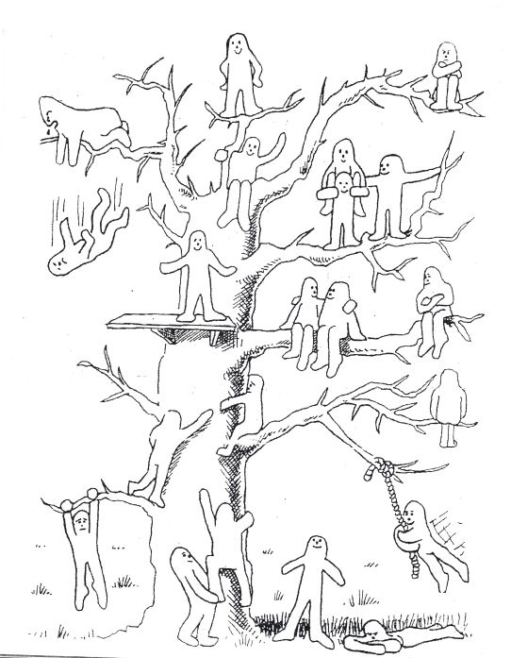
Reflection – the story so far
Four Strands (Cognitive, linguistic, physical, social & emotional)
Exploratory – Presentational Talk
Clarify
Speaker
What have you trialled/achieved since session 1?
What impact has this had? How do you know?
What do you mean when you say…?
Can you explain a bit more about?
Does that mean..?
A
B
Probe
C
Why do you think..?
What do you think would be the effect of..?
Could you think about trying…?
What would you do differently now?

Slide 5
OFSTED English Review https://www.gov.uk/government/publications/curriculum-research-review-series-english High quality English… Speaking & Listening
Identify the interrelated aspects (4 strands of the framework)
Equip children with the right knowledge and vocabulary on a topic
Opportunities for exploratory talk
Opportunities for presentational talk
Focus on selecting and using appropriate grammar and register
Teacher modelling spoken language
Frequent opportunities to practise, refine and apply spoken language knowledge and skills

Slide 6
The Dialogic Classroom
What is a dialogic classroom?
How can we create one?
What is the role of the teacher?
Notes:
What is a dialogic classroom? A dialogic classroom is quite simply, one in which there is dialogic teaching- a pedagogy which emphasises the power of classroom talk to extend students thinking and understanding. The term dialogic teaching has been employed by many but most notably by Robin Alexander in his Towards Dialogic Teaching. You are going to work with your colleagues to create a shared definition of dialogic teaching- negotiate and develop your understanding together.

Slide 7
Fed-in facts
What is a dialogic classroom?

Slide 8
What oracy skills did you need to complete this task?
Notes:
What skills did you need to be able to do this? Think about them in terms of the four strands

Slide 9
The Oracy Framework
Content
Choice of content to convey meaning & intention
Building on the views of others
Structure
Structure & organisation of talk
Working with others
Clarifying & summarising
Guiding or managing interactions
Turn-taking
Seeking information & clarification through questions
Summarising
Vocabulary
Voice
Appropriate vocabulary choice
Listening & responding
Fluency & pace of speech
Tonal variation
Clarity of pronunciation
Voice projection
Self-regulation
Listening actively & responding appropriately
Language
Register
Grammar
Maintaining focus on task
Time management
Confidence in speaking
Reasoning
Self-assurance
Liveliness & flair
Body language
Rhetorical techniques
Giving reasons to support views
Critically examining ideas & views expressed
Audience awareness
Gesture & posture
Facial expression & eye contact
Rhetorical techniques such as metaphor, humour, irony & mimicry
Taking account of level of understanding of the audience
Physical
Linguistic
Cognitive
Social & Emotional

Slide 10
Notes:
Re-emphasise the link between learning to and through talk- to thrive in a dialogic classroom (learning through talk) you must also have the skills to talk- which is why we must teach oracy.

Slide 11
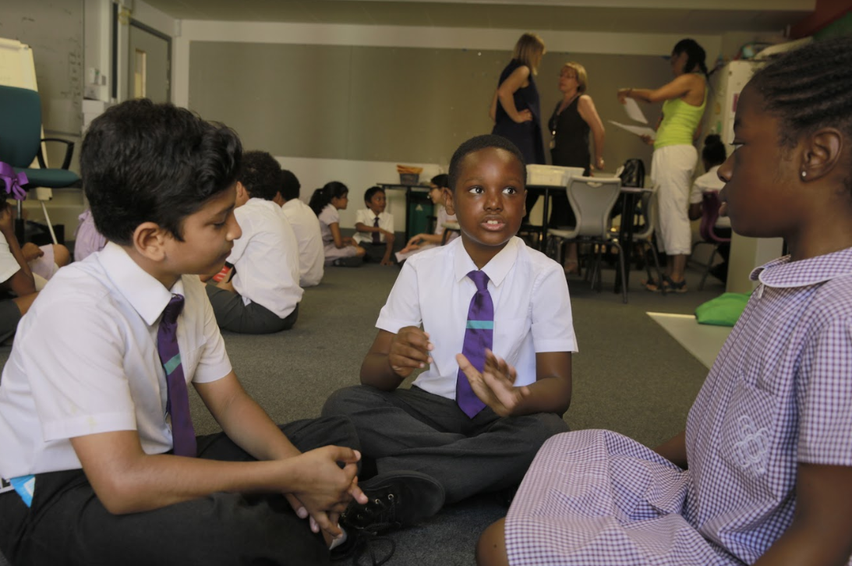
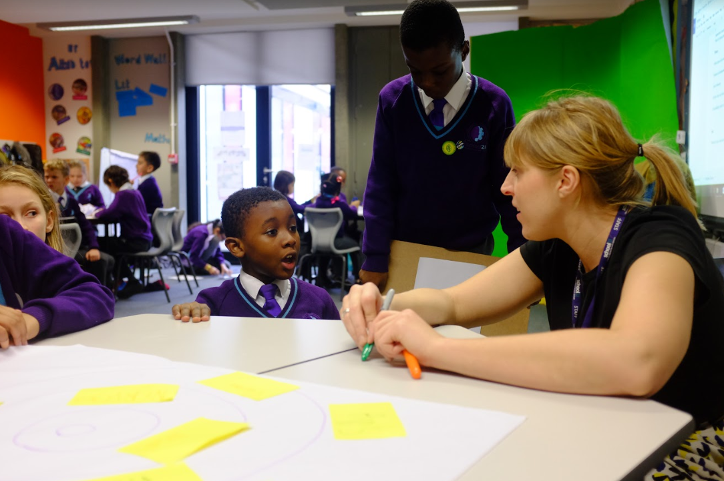
Classroom interactions
Student – student interactions
Teacher – student interactions
Notes:
Explain that dialogic teaching relates to the interactions between teachers and students, as well as students themselves. Explain that we are focusing on student- student relationships but that this will have implications for the way you as teachers interact with students.

Slide 12
Ingredients of a dialogic classroom
Purpose of talk
Structure
Scaffolds
Reflection

Slide 13
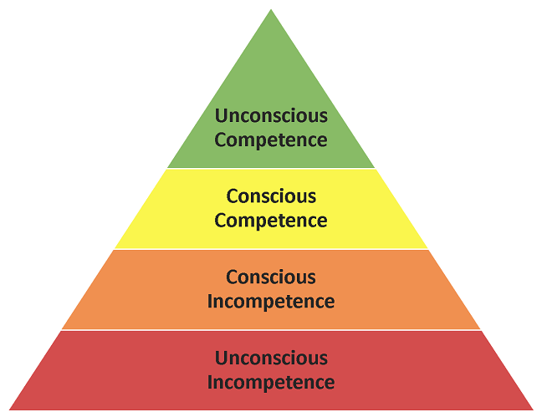
Reflection: developing metacognition
(*Broadwell, 1969)
Notes:
Reaffirm link to the exercise they completed after the ‘fed-in facts’ activity- outlining the skills they needed to complete that task. They were unconsciously competent- students begin with unconscious competence- we must move them up the pyramid.

Slide 14
Structure
Notes:
Look at examples – any not sure about?
Hand out / electronic copy
Complete an activity to try a couple

Slide 15
Credit: L.Bisiker Expert Oracy Lead
Notes:
Some teachers incorporate into a display to make a pictorial representation in the classroom. Children become familiar with them so getting into groups (after practice) is not disruptive.

Slide 17
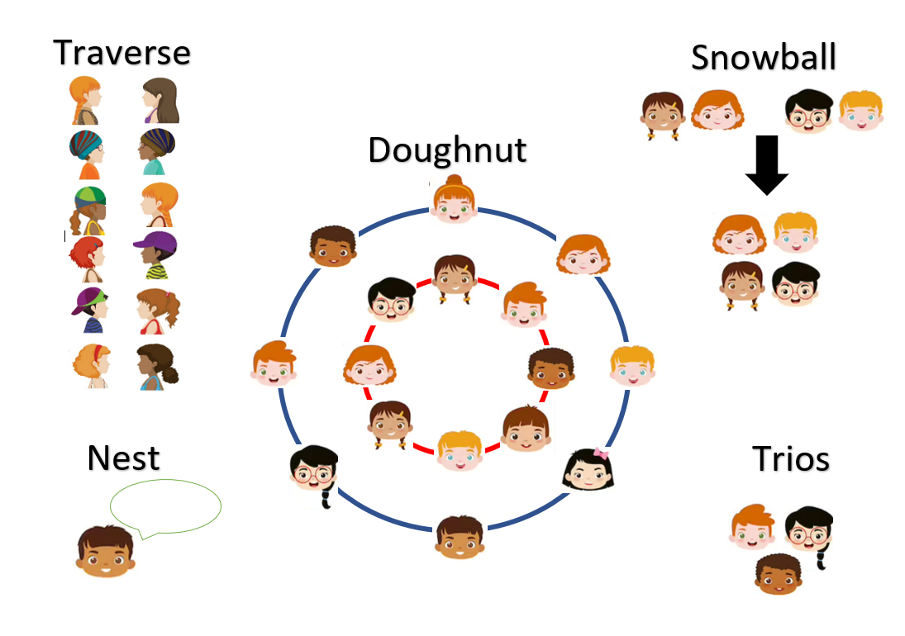
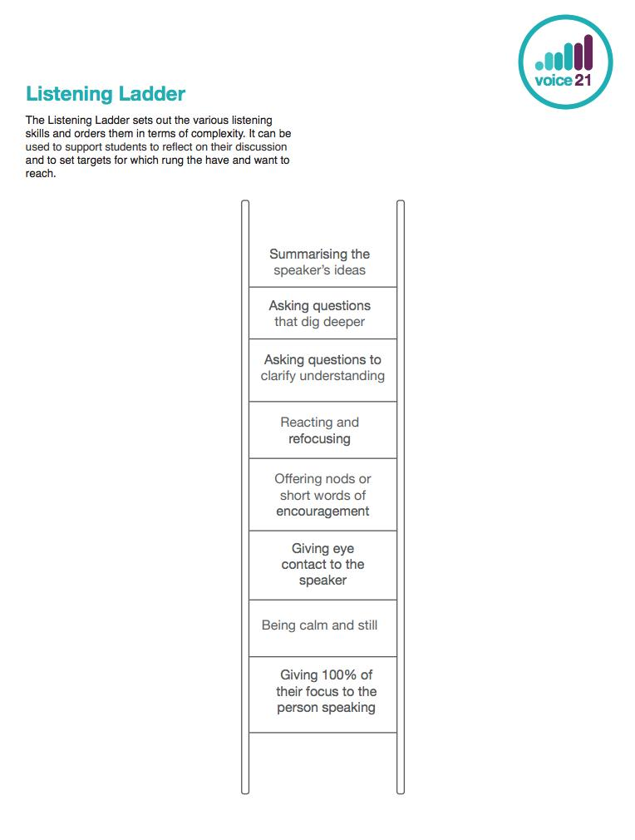
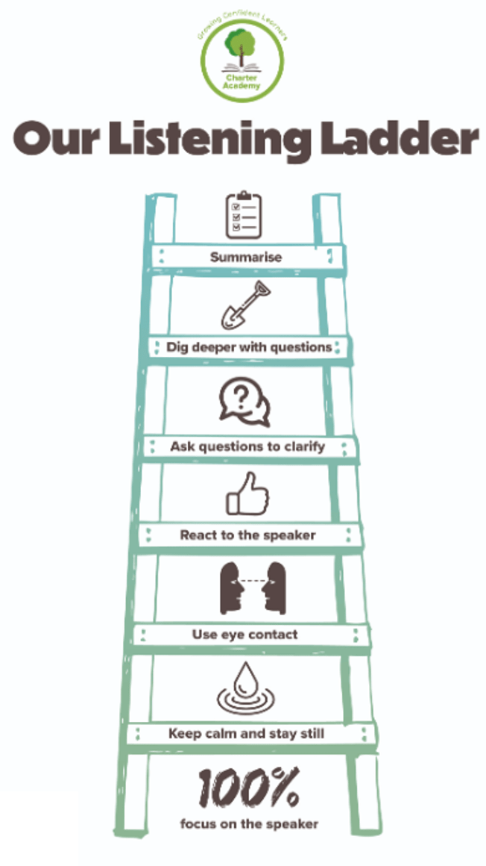
Notes:
For me, the first, most important thing to establish was listening. Passive, didn’t listen to each other, switch off.
One a week we introduced them. Now included in school guidelines. This was alongside grouping strategies.

Slide 18
Scaffolds: elevating the quality of talk
Scaffolding is a “process that enables a child or novice to solve a problem, carry out a task or achieve a goal that would be beyond his unassisted efforts” (Wood, Bruner and Ross 1976, 90).
A scaffold acts as a temporary supportive structure for a student to complete a task they otherwise could not have (Graves, Watts and Graves 1994, 44). As students become more confident, scaffolds will be needed less and less, until eventually they are not needed at all.
Sentence stems
Modelling
Key vocabulary

Slide 19
Modelling-
to and through talk !
Modelling
“You don’t say to children, ‘Right now we’re going to do some long division and I’m sure you all know how to do that, so just get on with it’.”
Notes:
“Talk is taken for granted,” a belief among some that “talking” is natural… Often, that’s not a conscious thought but, you can see it in action when teachers give children discussion or group work tasks without any training on how to structure those conversations.

Slide 20
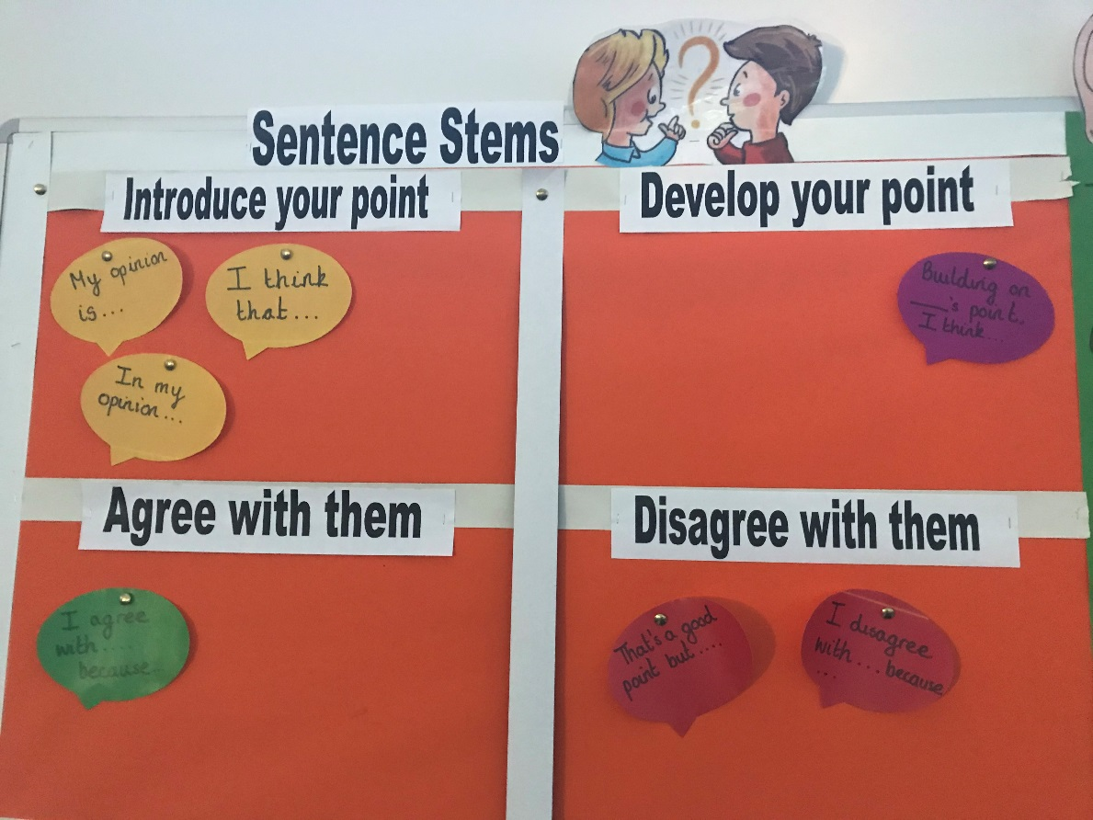
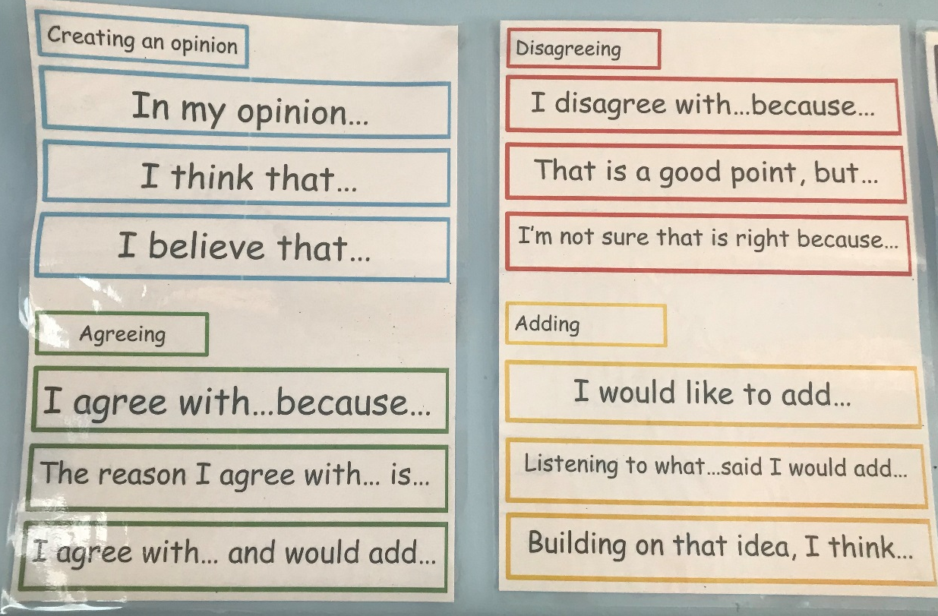
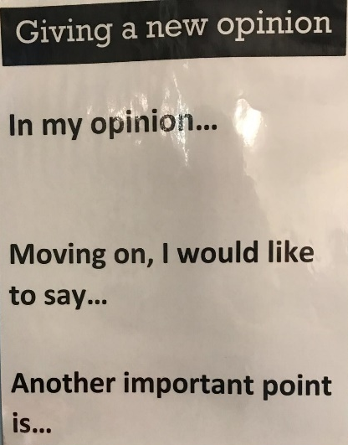
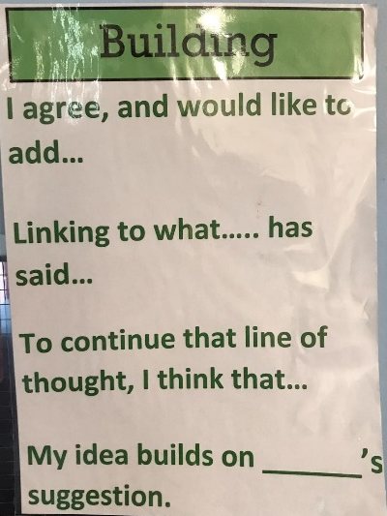
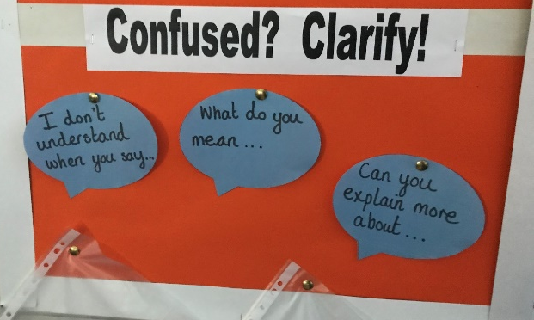
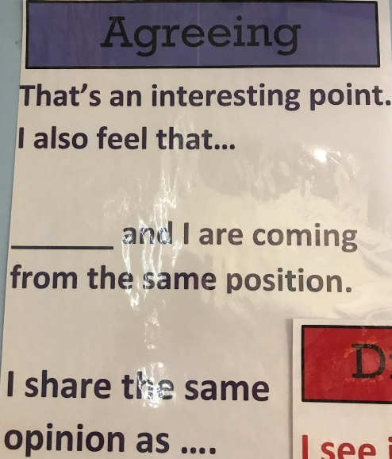
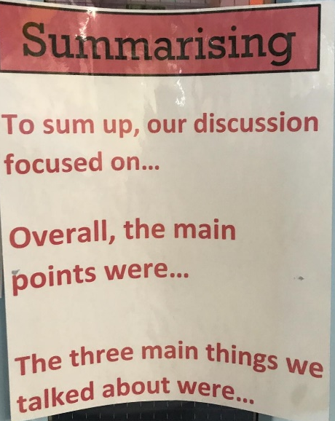
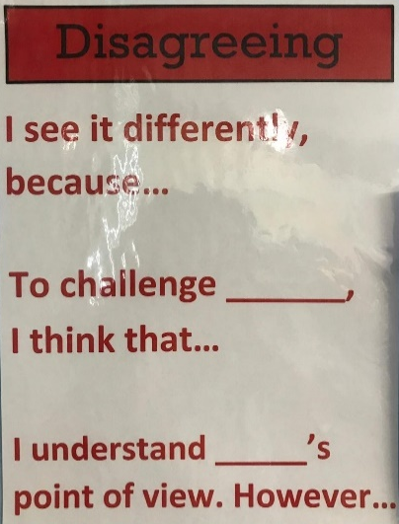
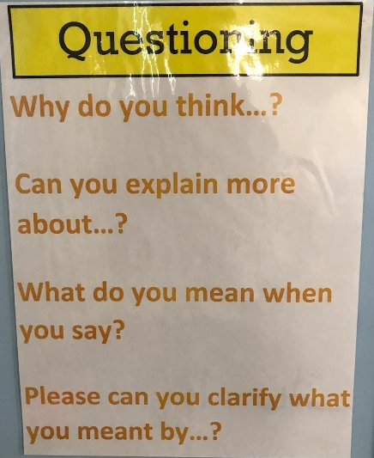
Sentence stems
Credit: L.Bisiker Expert Oracy Lead

Slide 21
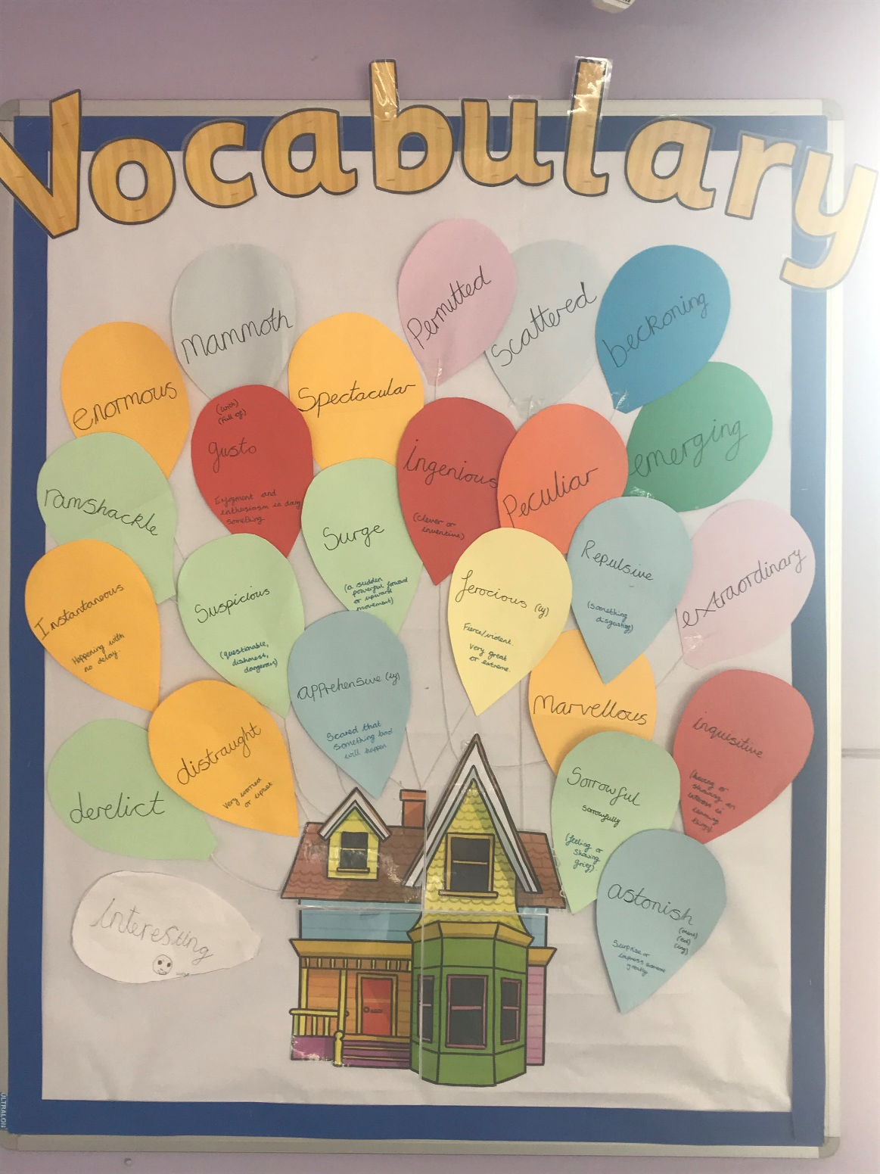
Key vocabulary
Credit: L. Bisiker Expert
Oracy Lead

Slide 22
Listening Nest to collect your thoughts
What do you expect from your children when you ask them to listen to you / each other?
Do children know this expectation?
How do you know they are listening?
Is their listening passive or active?

Slide 23
Learning through Listening
Learning to Listen

Slide 24
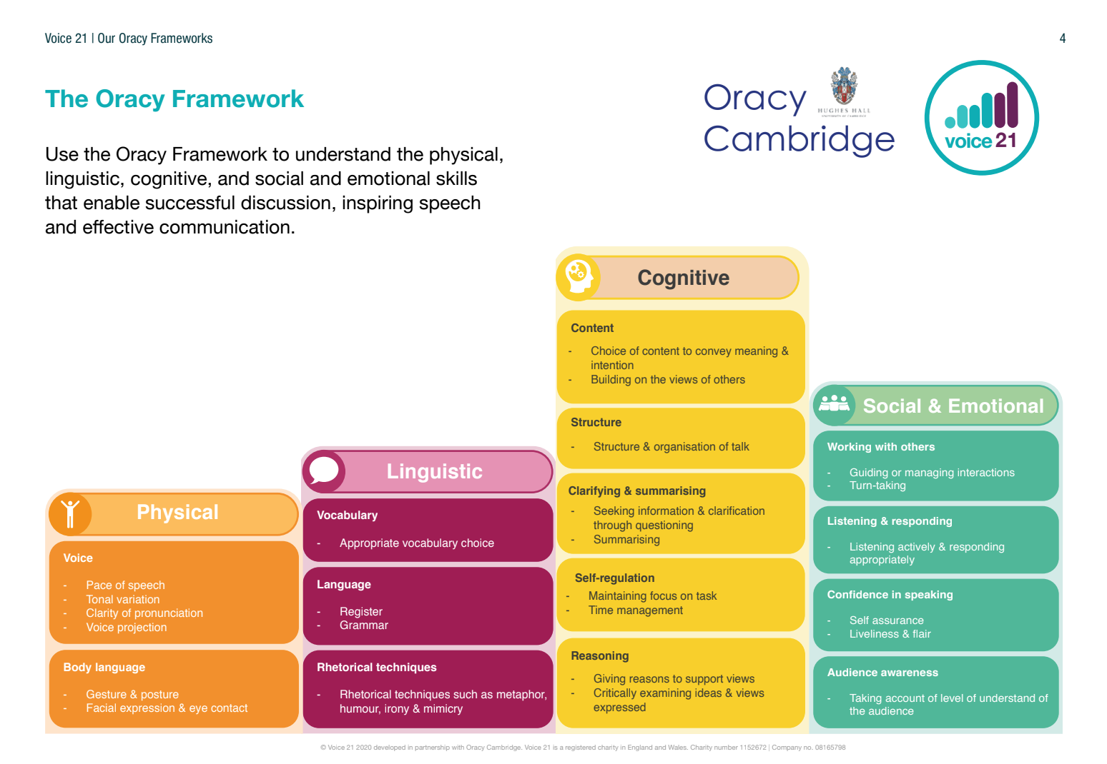
The oracy framework is a useful tool for organising and catagorising listening skills. Consider the four strands of oracy and which listening skills sit beneath each of them.

Slide 25
The physical markers of listening are often the easiest to teach and usually the best place to start.
Facing the speaker
Making eye contact
Building on what has been said
The linguistic skill most closely linked to listening is paraphrasing. This demonstrates that you have listened and understood. Ensure the differences of paraphrasing and summarising are explored with pupils.
Listening is a cognitive process through which we develop understanding.
Summarising
Asking questions
Building upon what has been said
We often talk about the effect a speaker can have on a listener but rarely talk about the reverse. Consider the difference between talking to a person who looks bored and someone who looks interested and asks questions.
Transforming Teaching and Learning through Talk- The Oracy Imperative, A. Gaunt & A Stott 2019

Slide 26
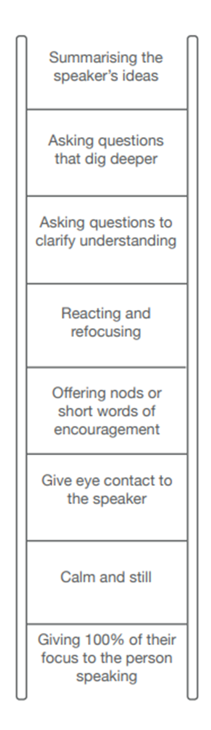
Credit for display: L. Bisiker Expert Oracy Lead

Slide 28
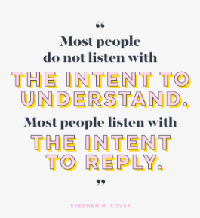

Slide 29
Developing discussion guidelines
May I suggest …?
What are the ingredients of a great discussion?
It might work better if …
How about …?
Could you change that to …?

Slide 30
Available from: www.thinkingtogether.educ.cam.ac.uk/resources/Ground_rules-traffic_lights.pdf

Slide 31
Available from: www.thinkingtogether.educ.cam.ac.uk/resources/Ground_rules-traffic_lights.pdf

Slide 32
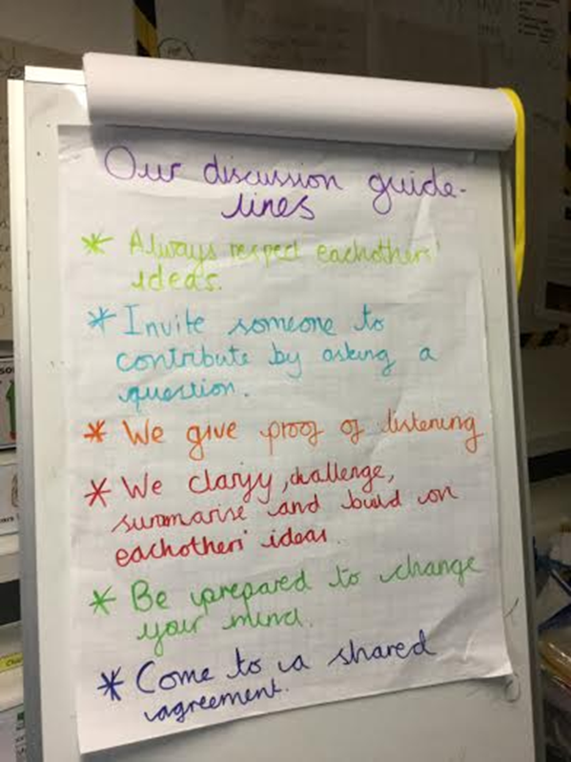
Developing discussion guidelines

Slide 33
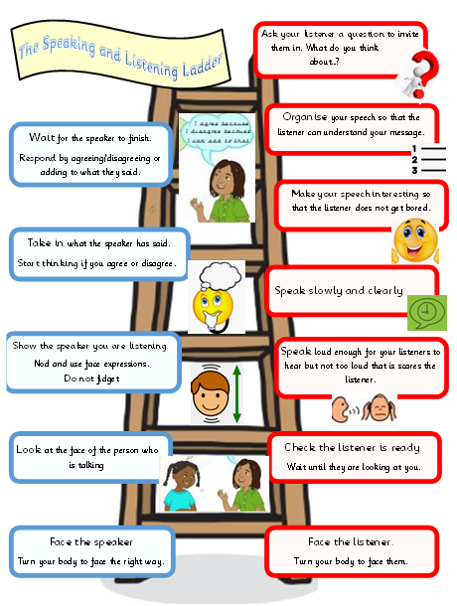
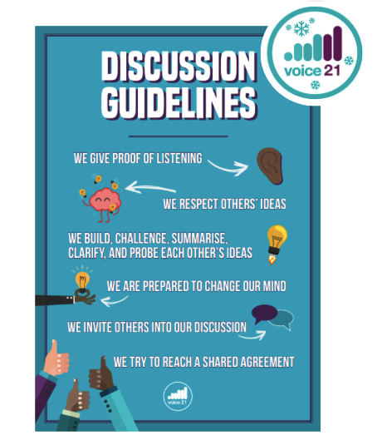

Slide 34
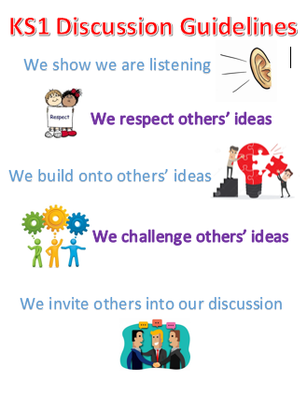
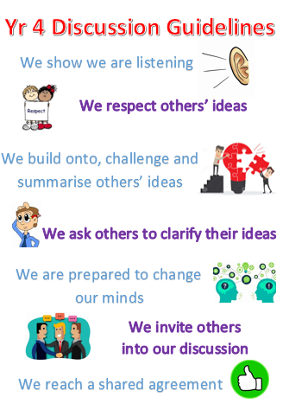
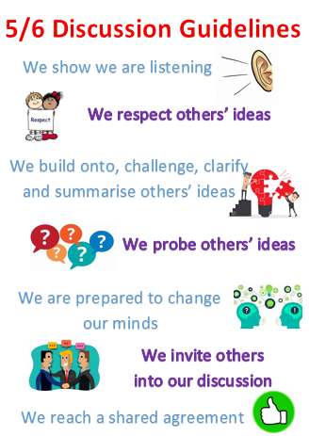
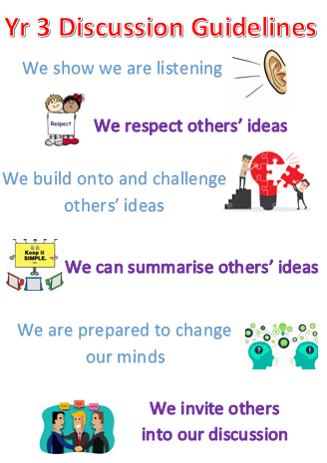
Credit: L. Bisiker Expert Oracy Lead / Parks

Slide 35
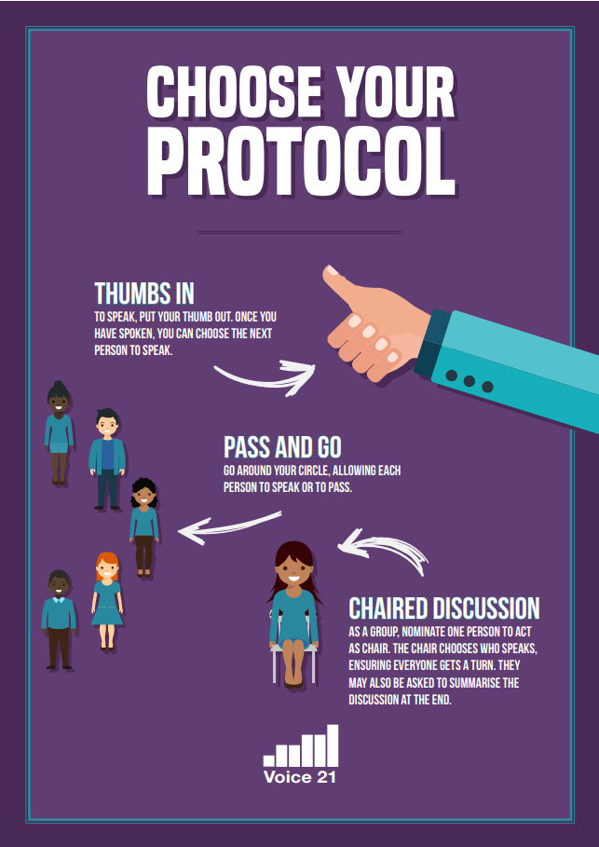
Discussion What are the main barriers stopping teachers from using talk and how can they be overcome?

Slide 36
The teacher’s role is redundant in a truly dialogic classroom
B
Linking to that … I agree / disagree with you because …
A
I agree / disagree because …
C - Silent Summariser
The main points you raised were …

Slide 37
What are your key take-aways from today?

Slide 38
What are your actions to work on to feedback about next time? You could…
Trial a new grouping
Use a talk scaffold
Think about developing listening
Develop talk guidelines

Slide 40
Further Oracy Support coming up …
Session 3: Oracy across the curriculum - Thursday 1st February at SDSA
Oracy Networks – open to all
18th April 9am – 12 at NSPCC Includes opportunities to visit schools to see ‘oracy in action’
15th February ‘Oracy Teach Meet’ hosted by Humberstone Jnr
Bespoke consultant in-school sessions available by request

Slide 41
Session evaluation

