Slide 1
“[Talk is] the most powerful tool of communication in the classroom and it’s fundamentally central to the acts of teaching and learning”
-Professor Frank Hardman
Introduction to Oracy
Course lead: Hannah Cooper

Slide 2
You can start a conversation with ANYONE
What is the best conversations starter ever?
What makes a great conversation starter?
If you could learn the answer to one question about your future, what would it be?
What’s your favourite way to waste time?
What three words best describe you?

Slide 3
To understand the term ‘oracy’ and how it supports teaching and learning
Introduction to the Oracy Framework
Aims of the day

Slide 4
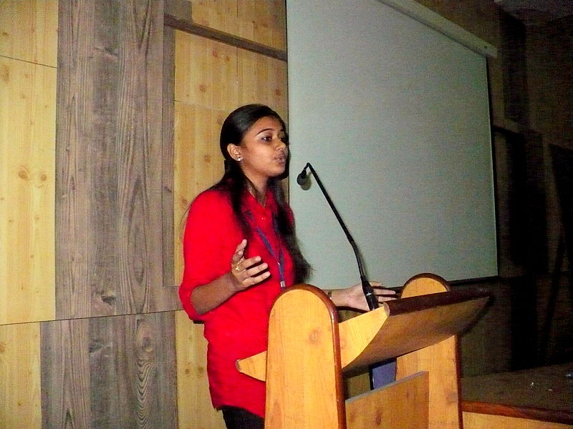
What is oracy?
This Photo by Unknown Author is licensed under CC BY-SA-NC
I think that oracy means …
I think oracy is …
This Photo by Unknown Author is licensed under CC BY-NC-ND
This Photo by Unknown Author is licensed under CC BY-ND
Notes:
How the stimulus links to the purpose?

Slide 5
“[Oracy] is what the school does to support the development of children’s capacity to use speech to express their thoughts and communicate with others, in education and in life”
-Professor Robin Alexander
Oracy is for every child to find their voice, metaphorically and literally

Slide 6
Why learn oracy?
Diamond 9 Activity
Notes:
Jot down on post-its what skills were used to tackle this activity (we will return to these later)

Slide 7
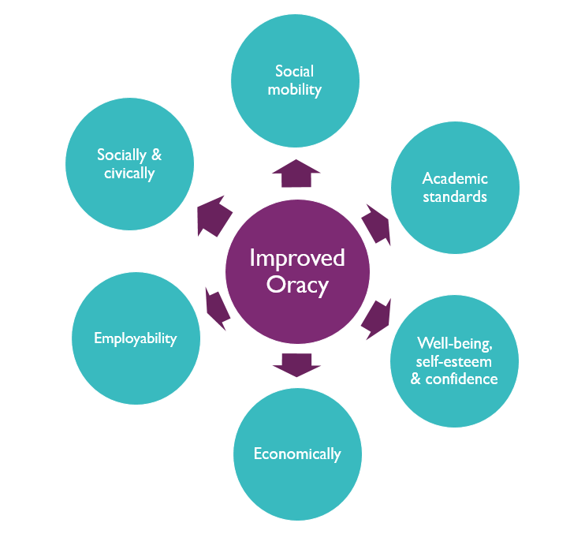
Why is oracy important?
Oracy is important for…
We know this because…
Yes, and…

Slide 8
The case for oracy
Notes:
What oracy happens in your classroom – post it note.
Now organise into the activities that are by chance / planned for

Slide 9
OFSTED English Review https://www.gov.uk/government/publications/curriculum-research-review-series-english High quality English… Speaking & Listening
Identify the interrelated aspects (4 strands of the framework)
Equip children with the right knowledge and vocabulary on a topic
Opportunities for exploratory talk
Opportunities for presentational talk
Focus on selecting and using appropriate grammar and register
Teacher modelling spoken language
Frequent opportunities to practise, refine and apply spoken language knowledge and skills

Slide 10
OFSTED English Review https://www.gov.uk/government/publications/curriculum-research-review-series-english
‘There is a risk that planning for English teaching ends up focusing on using modalities (pedagogy) at the expense of identifying the foundational knowledge of language that pupils need for comprehension or communication in whatever modality they are using.’
The exact case for learning to talk and Learning through talk

Slide 11
What does this mean for teachers?
Notes:
Re-emphasise the link between learning to and through talk- to thrive in a dialogic classroom (learning through talk) you must also have the skills to talk- which is why we must teach oracy.

Slide 12
What Speaking & Listening happens in your classroom?
Post-it
Notes:
Organise into 2 sections – incidental & taught
Will return to these for exploratory & presentational activity

Slide 13
Exploratory talk vs Presentational talk
Exploratory talk
‘exploratory talk which is typical of the early stages of approaching new ideas […]Exploratory talk is hesitant and incomplete because it enables the speaker to try out ideas, to hear how they sound, to see what others make of them, to arrange information and ideas into different patterns.’
Presentational talk
‘The difference between the two functions of talk is that in presentational talk the speaker’s attention is primarily focused on adjusting the language, content and manner to the needs of an audience, and in exploratory talk the speaker is more concerned with sorting out his or her own thoughts.’
Barnes, 1992

Slide 14
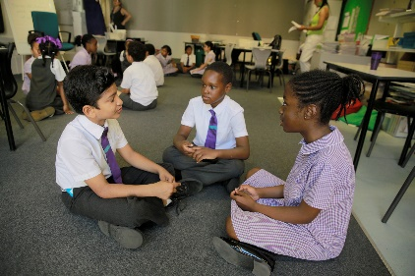
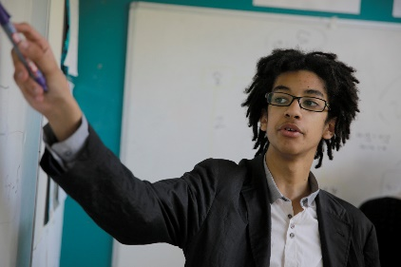
Different types of talk
Exploratory
talk
Presentational
talk
Notes:
Human ‘where do you stand?’ with different activities on a human talk continuum.

Slide 15
Different types of talk
Hot seating
Peer-to-peer verbal feedback
Discussion
Class assembly to school
Giving a summary
Role play
Exploratory
talk
Presentational
talk
Answering a teacher’s question
Debate
On the playground
Notes:
Human ‘where do you stand?’ with different activities on a human talk continuum.

Slide 16
A good speaker has a quality you can’t define
A: I bet you’re thinking
B: Yes, and…
No, actually…

Slide 17
What makes a good speaker?
https://www.google.co.uk/url?sa=t&rct=j&q=&esrc=s&source=web&cd=&cad=rja&uact=8&ved=2ahUKEwiNoqaigsX8AhWrQkEAHcu3CzoQtwJ6BAgKEAI&url=https%3A%2F%2Fwww.youtube.com%2Fwatch%3Fv%3DSoC8czSM8jQ&usg=AOvVaw1UErAqpXQ7h5KG9ccI0L5L
Penny Mallory
https://youtu.be/vzXeg-sdC4o

Slide 18
Oracy skills framework – an introduction
A skills framework is designed to organise teaching and learning, rather than to fully describe the phenomenon of speech. Some of its distinctions are artificial; it is not the whole story; like all tools, it will be improved as people use it.
We have divided oracy skills into four categories:
Cognitive
The deliberate application of thought to what you’re saying
Linguistic
Knowing which words and phrases to use, and using them
Physical
Making yourself heard, using your voice and body as an instrument
Social
Engaging with the people around you; knowing you have the right to speak

Slide 19
Oracy skills framework

Slide 20
angry
excited
sad
“It’s only 3 weeks until half term!”
nervous
worried
confused

Slide 21
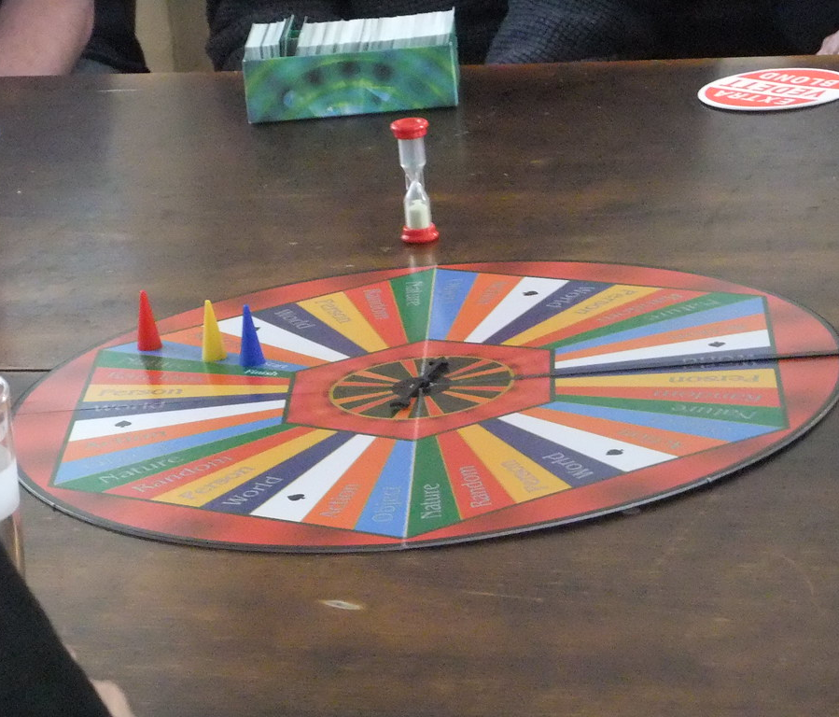
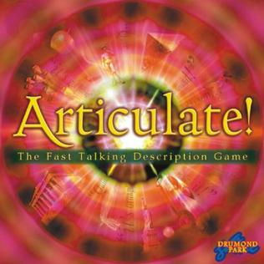
Articulate
Simile
Metaphor
Factor
Prime number
Shade
Tone
This Photo by Unknown Author is licensed under CC BY-SA
This Photo by Unknown Author is licensed under CC BY-SA

Slide 22
1 – 20 Game

Slide 23
If I ruled the world, I would …
This Photo by Unknown Author is licensed under CC BY-SA

Slide 24
Oracy skills framework

Slide 25
Oracy skills framework
Social
Cognitive
Linguistic
Physical

Slide 26
The Oracy Framework
Content
Choice of content to convey meaning & intention
Building on the views of others
Structure
Structure & organisation of talk
Working with others
Clarifying & summarising
Guiding or managing interactions
Turn-taking
Seeking information & clarification through questions
Summarising
Vocabulary
Voice
Appropriate vocabulary choice
Listening & responding
Fluency & pace of speech
Tonal variation
Clarity of pronunciation
Voice projection
Self-regulation
Listening actively & responding appropriately
Language
Register
Grammar
Maintaining focus on task
Time management
Confidence in speaking
Reasoning
Self-assurance
Liveliness & flair
Body language
Rhetorical techniques
Giving reasons to support views
Critically examining ideas & views expressed
Audience awareness
Gesture & posture
Facial expression & eye contact
Rhetorical techniques such as metaphor, humour, irony & mimicry
Taking account of level of understanding of the audience
Physical
Linguistic
Cognitive
Social & Emotional
Notes:
Refer back to what makes a good speaker

Slide 27
Using the Oracy Framework
Supporting teachers’ understanding of oracy
Diagnosing the needs of your students
Shared language – giving feedback – setting success criteria

Slide 28
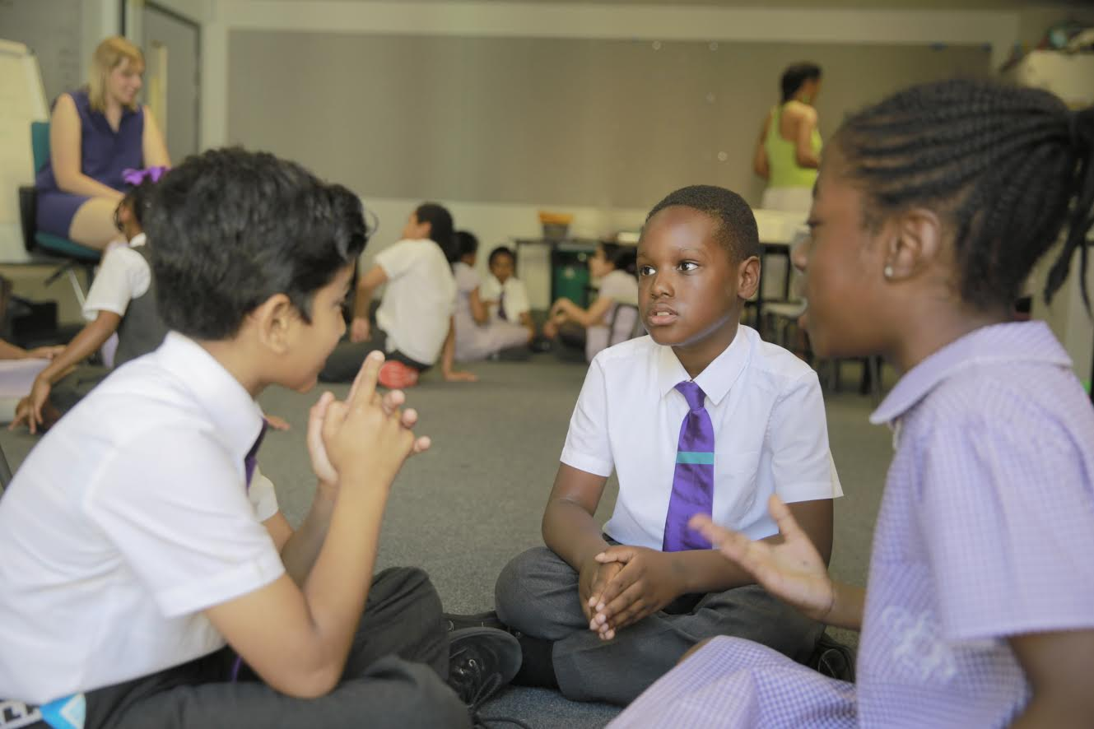
Your Classroom Practice
How does talk support learning?
What are the expectations for talk?
Are there opportunities to develop the four strands?
Are children learning to talk?
Are children learning through talk?
What was your role in the lesson?
Consider the Teacher Benchmarks

Slide 29
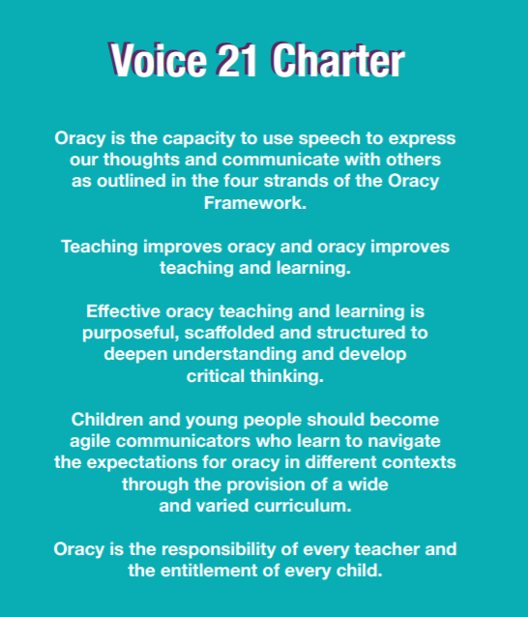
Final thoughts …

Slide 30
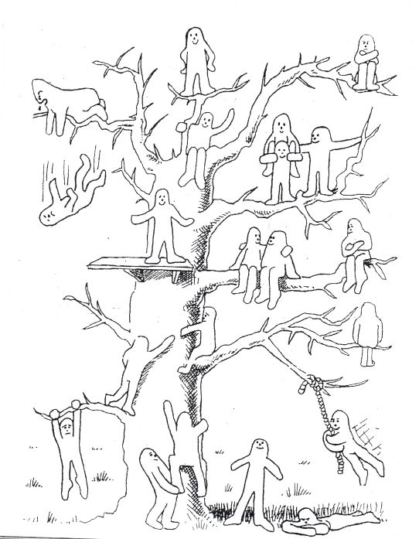
Which blob best represents you today?

Slide 31
Further Oracy Support
Session 2: Intro to discussion strategies, types of talk & listening
skills - 14th December at SDSA
Session 3: Oracy across the curriculum - 1st February at SDSA
Oracy Networks – open to all
18th January & 18th April 9am – 12 at NSPCC
Includes opportunities to visit schools to see ‘oracy in action’
Twilight team sessions
Twilight Oracy Teach Meets
Bespoke consultant in-school sessions available by request payable at SLA rate

Slide 32
Session evaluation

